Slide 1
Flexible Bayesian Regression Models for the Detection of Interactions in Exposure Mixture Studies
Elizabeth Zhang
Advisor: Amy Wagaman

Slide 2
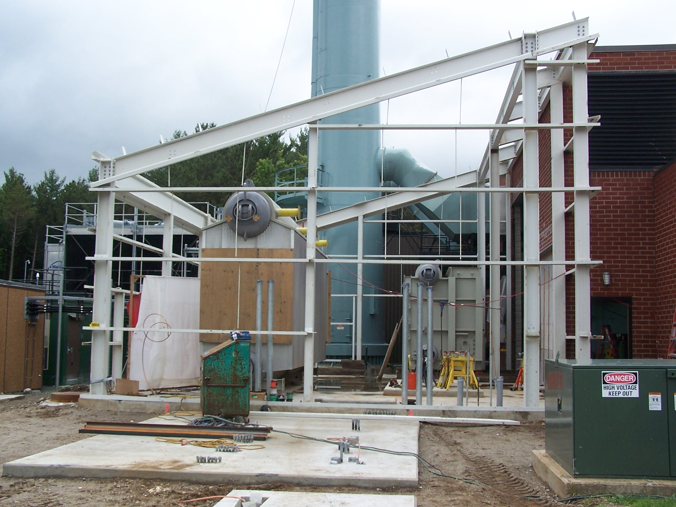
Amherst’s Cogeneration Plant

Slide 3
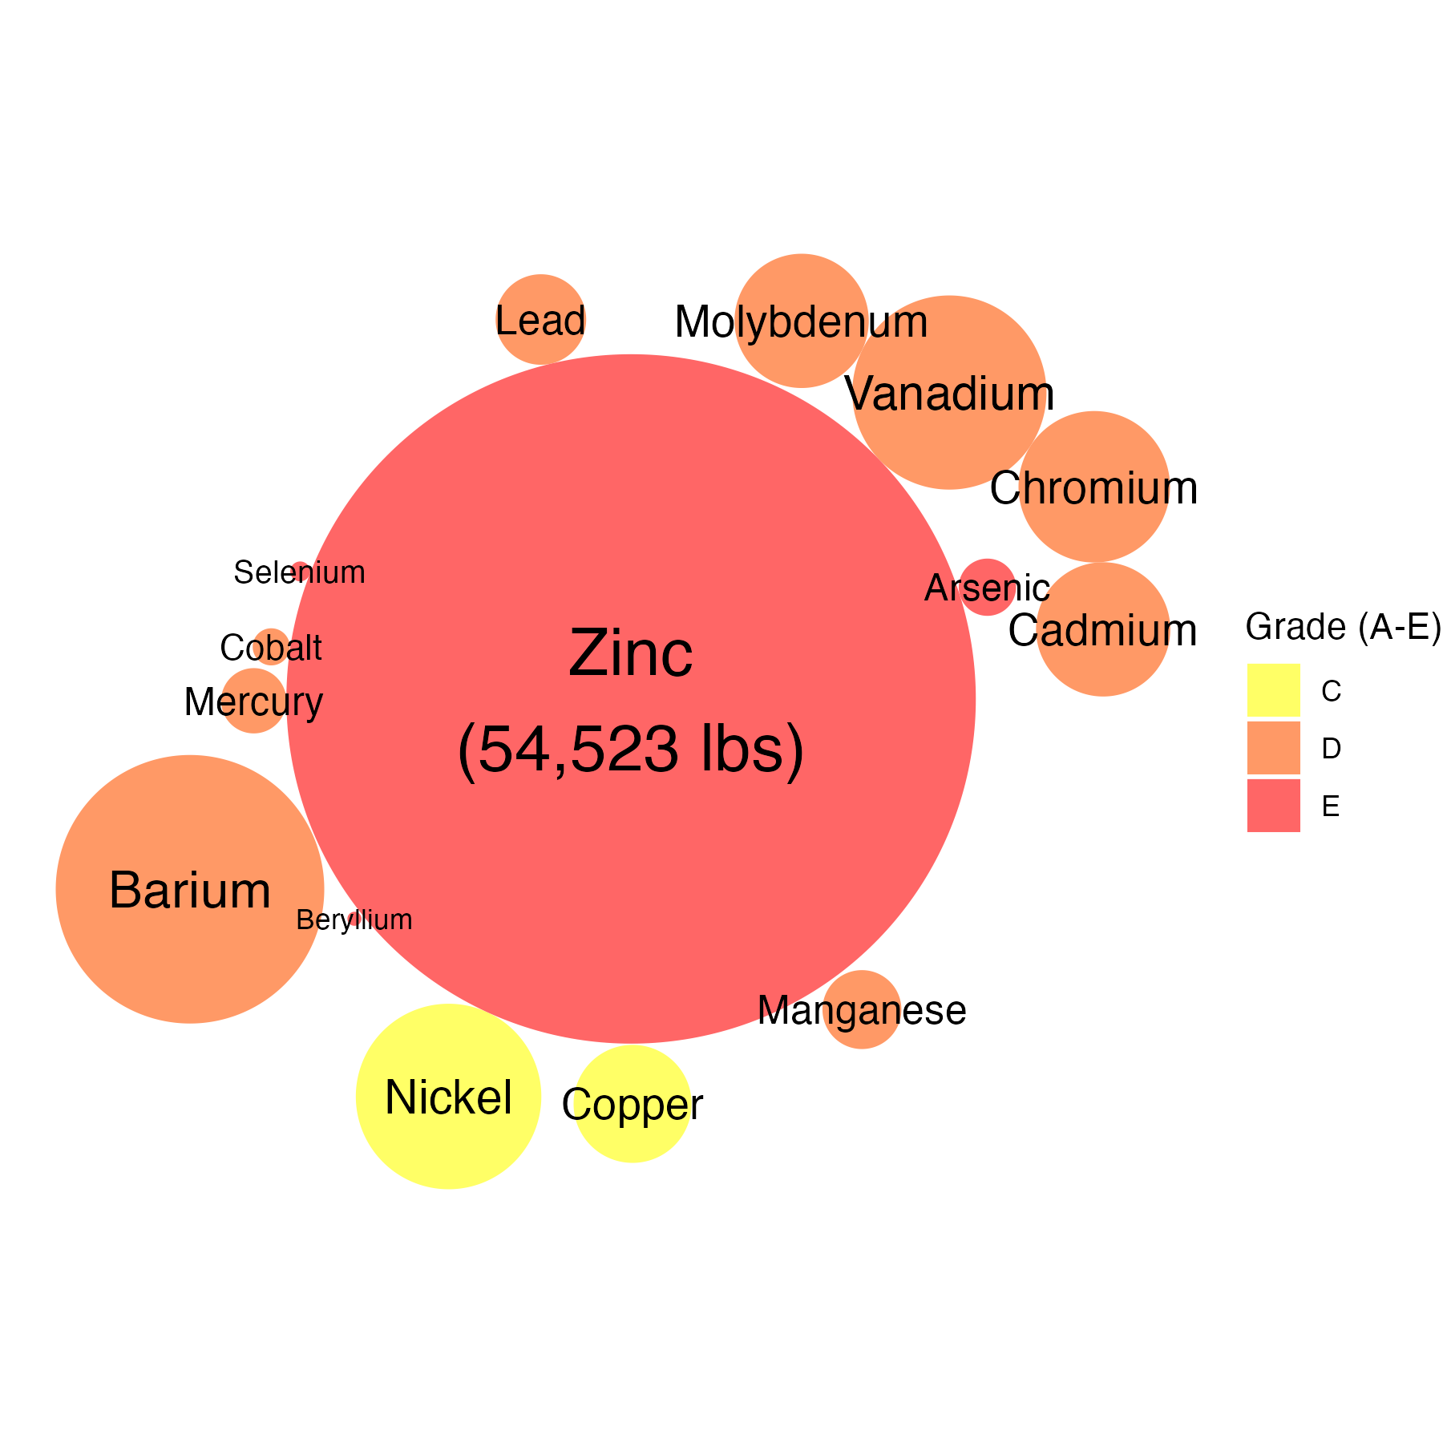
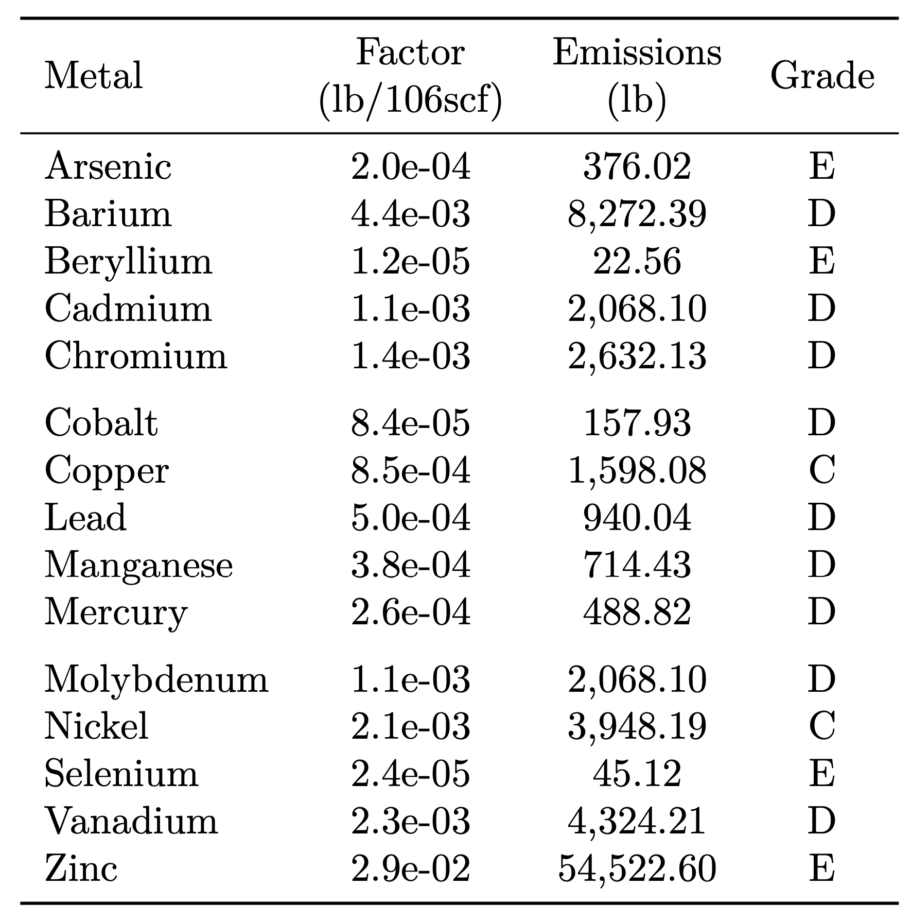
In 2023, the Cogen plant consumed 199 million cubic feet of natural gas

Slide 4
We are all exposed to chemical pollution

Slide 5
A mixtures approach to risk assessment

Slide 6
Mixtures come with statistical challenges
High-dimensionality
Multicollinearity
Non-linear univariate effects
Non-additive interaction effects
→ the typical multiple linear regression framework is insufficient

Slide 7
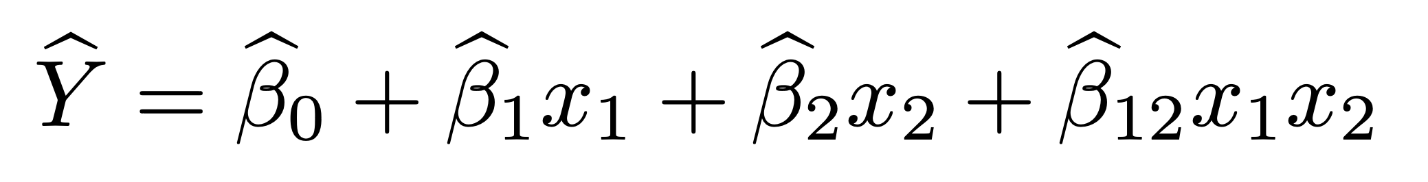
Non-additive interaction
Additive effect:
Non-additive interaction effect:
An example fitted linear regression…

Slide 8
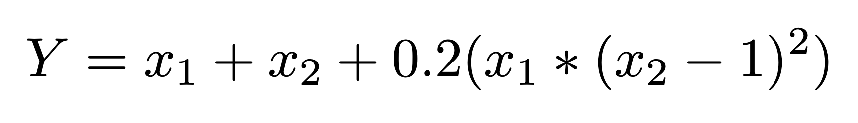
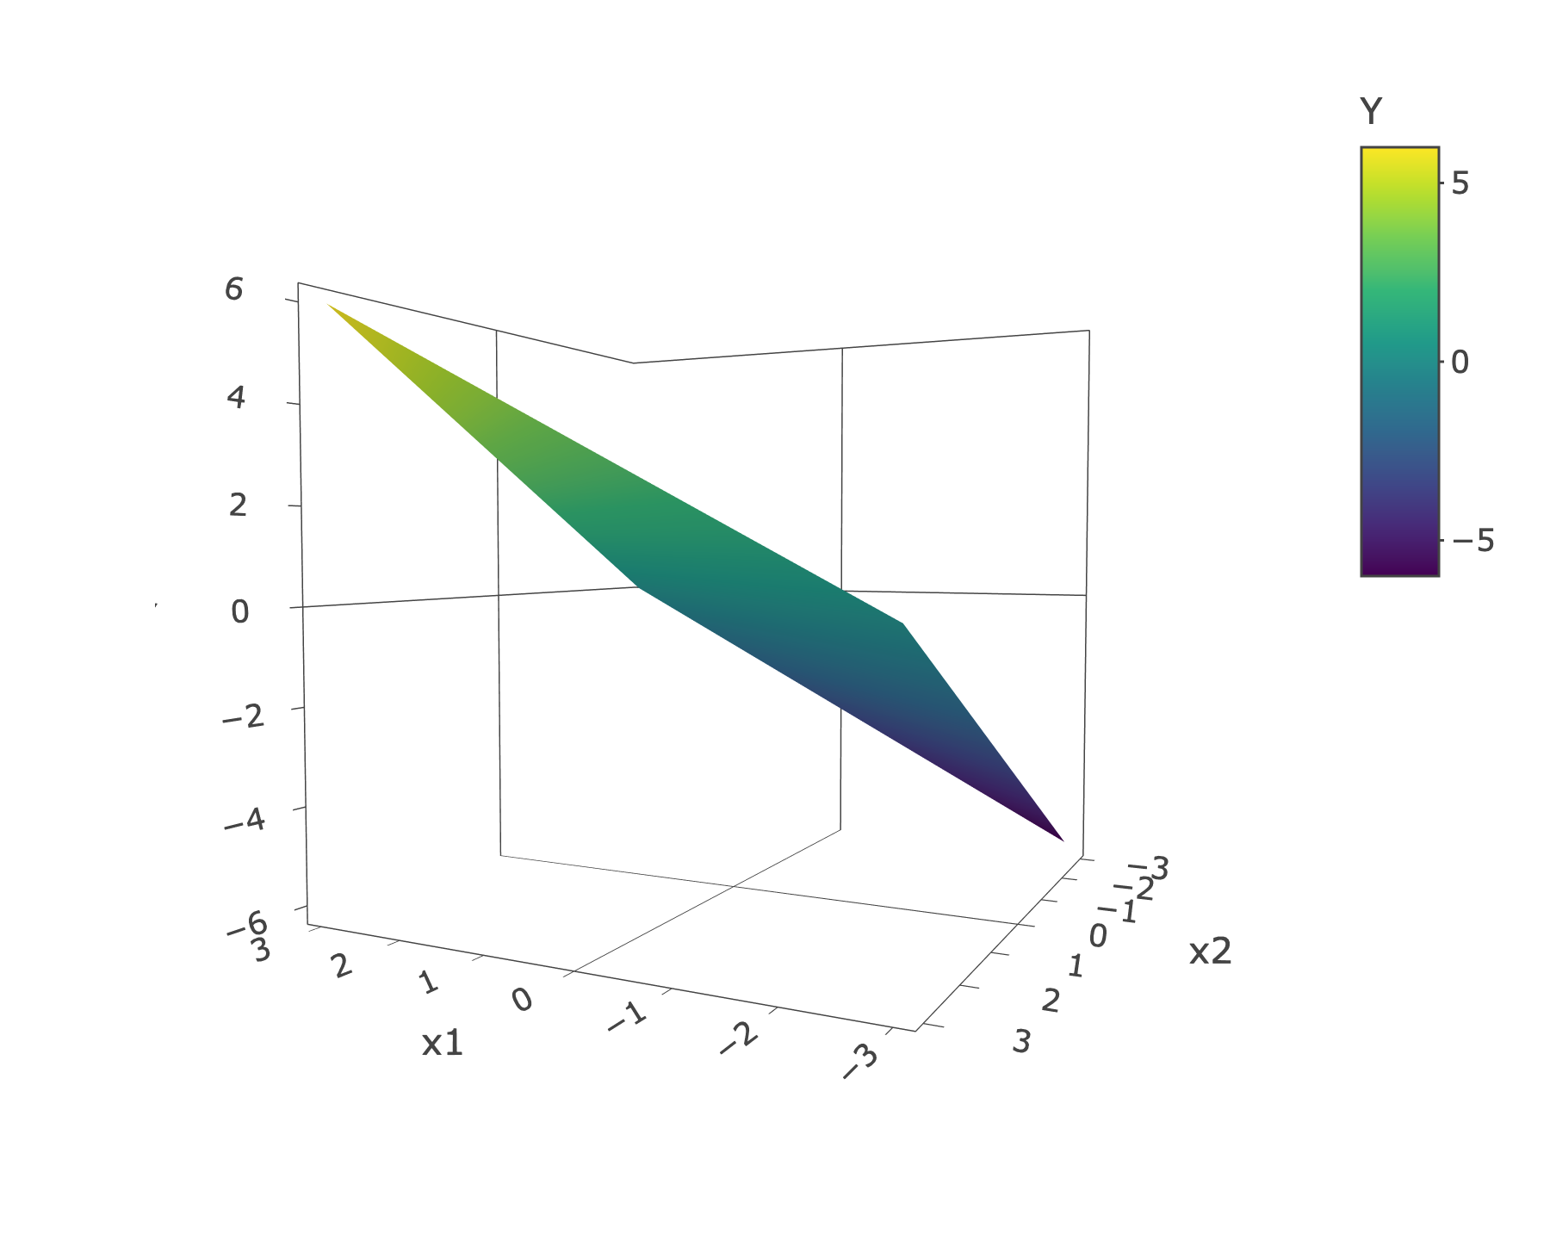
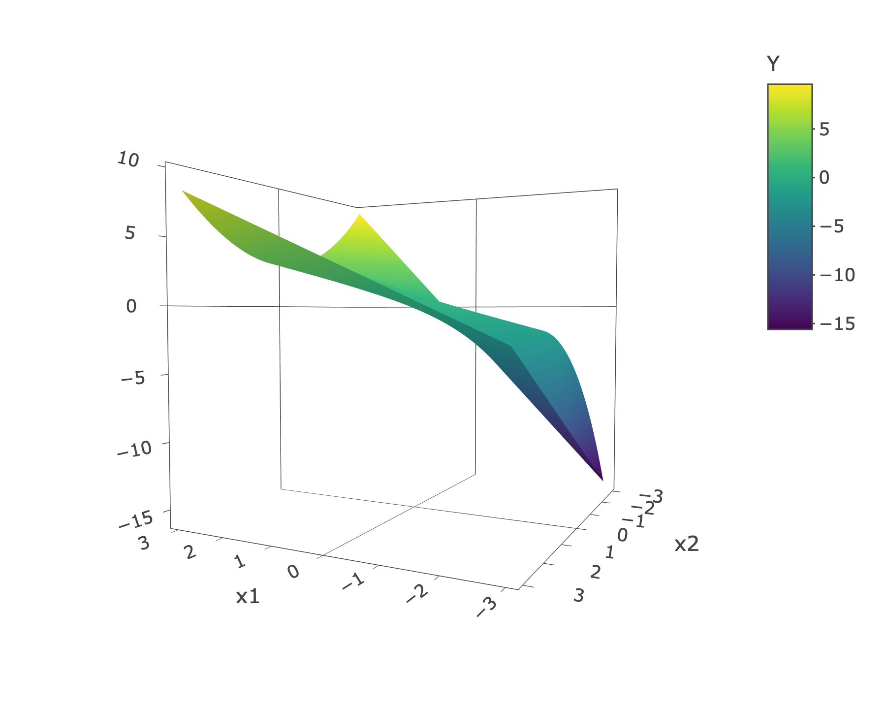
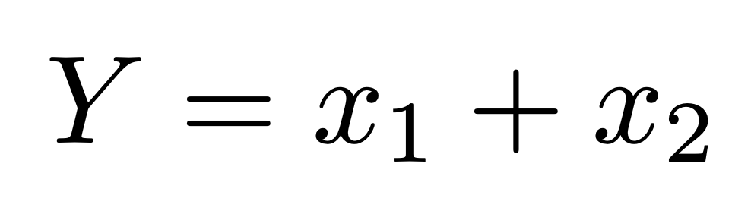
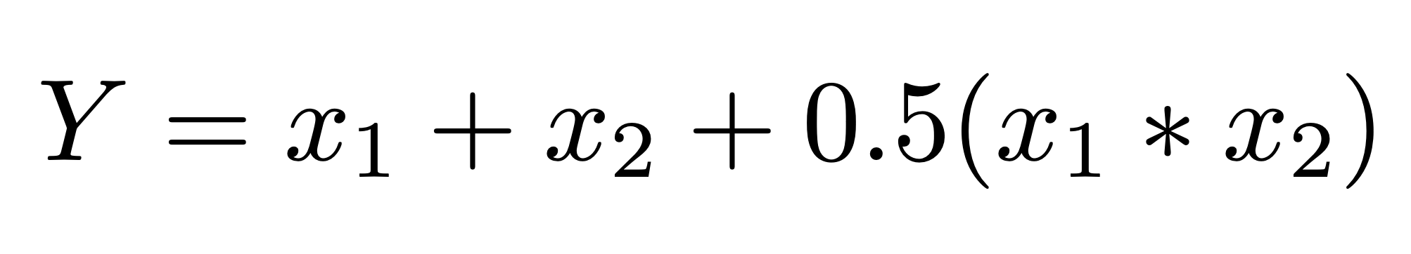
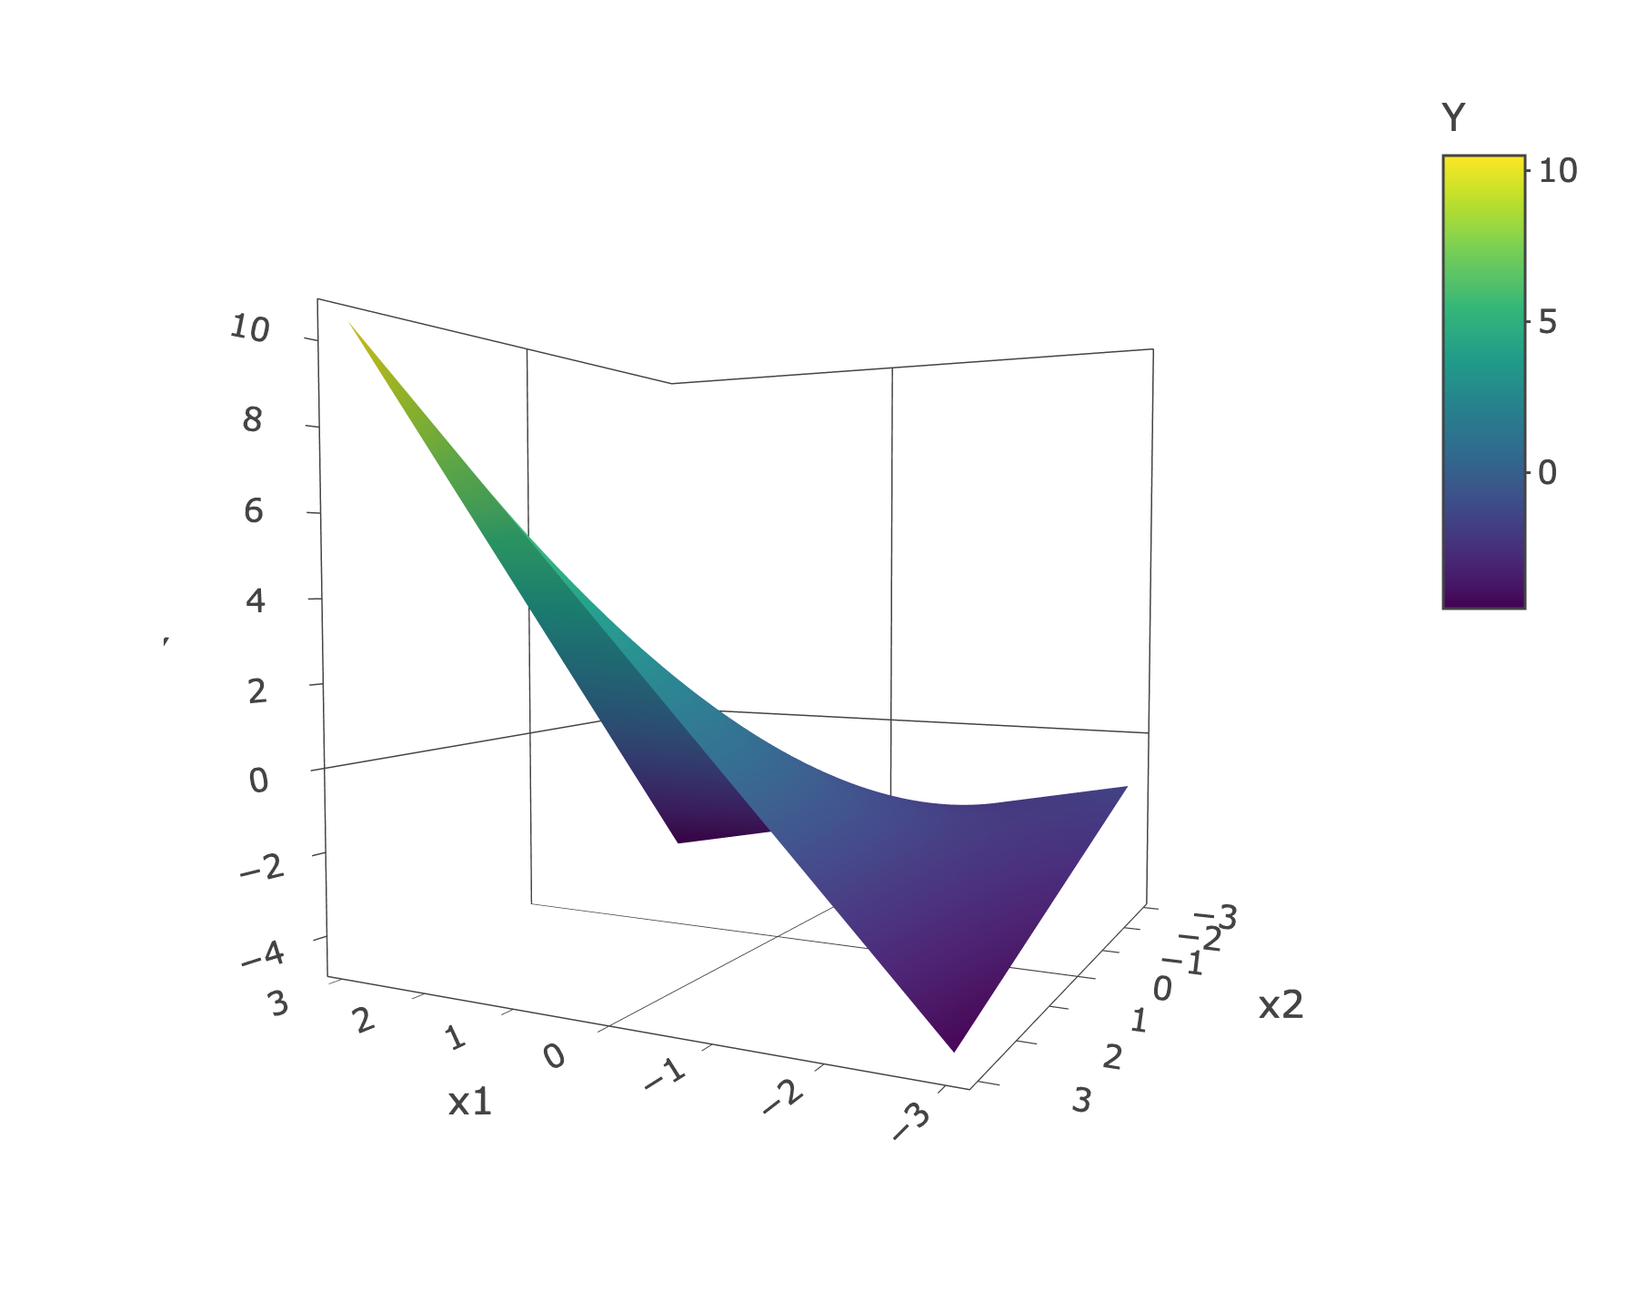
Interactions have many functional forms
Additive effect
Polynomial
Multiplicative
Notes:
“Flat plane” — flat surface, flat because it’s a plane

Slide 9
Interactions are high-dimensional
As, Cd, Co, Hg, Ni, Tl, Pb, Mo, Sb, Sn
As-Cd, As-Co, As-Hg, As-Ni, As-Tl, As-Pb, As-Mo, As-Sb, As-Sn, Cd-Co, Cd-Hg, Cd-Ni, Cd-Tl, Cd-Pb, Cd-Mo, Cd-Sb, Cd-Sn, Co-Hg, Co-Ni, Co-Tl, Co-Pb, Co-Mo, Co-Sb, Co-Sn, Hg-Ni, Hg-Tl, Hg-Pb, Hg-Mo, Hg-Sb, Hg-Sn, Ni-Tl, Ni-Pb, Ni-Mo, Ni-Sb, Ni-Sn, Tl-Pb, Tl-Mo, Tl-Sb, Tl-Sn, Pb-Mo, Pb-Sb, Pb-Sn, Mo-Sb, Mo-Sn, Sb-Sn
45
As-Cd-Co, As-Cd-Hg, As-Cd-Ni, As-Cd-Tl, As-Cd-Pb, As-Cd-Mo, As-Cd-Sb, As-Cd-Sn, As-Co-Hg, As-Co-Ni, As-Co-Tl, As-Co-Pb, As-Co-Mo, As-Co-Sb, As-Co-Sn, As-Hg-Ni, As-Hg-Tl, As-Hg-Pb, As-Hg-Mo, As-Hg-Sb, As-Hg-Sn, As-Ni-Tl, As-Ni-Pb, As-Ni-Mo, As-Ni-Sb, As-Ni-Sn, As-Tl-Pb, As-Tl-Mo, As-Tl-Sb, As-Tl-Sn, As-Pb-Mo, As-Pb-Sb, As-Pb-Sn, As-Mo-Sb, As-Mo-Sn, As-Sb-Sn, Cd-Co-Hg, Cd-Co-Ni, Cd-Co-Tl, Cd-Co-Pb, Cd-Co-Mo, Cd-Co-Sb, Cd-Co-Sn, Cd-Hg-Ni, Cd-Hg-Tl, Cd-Hg-Pb, Cd-Hg-Mo, Cd-Hg-Sb, Cd-Hg-Sn, Cd-Ni-Tl, Cd-Ni-Pb, Cd-Ni-Mo, Cd-Ni-Sb, Cd-Ni-Sn, Cd-Tl-Pb, Cd-Tl-Mo, Cd-Tl-Sb, Cd-Tl-Sn, Cd-Pb-Mo, Cd-Pb-Sb, Cd-Pb-Sn, Cd-Mo-Sb, Cd-Mo-Sn, Cd-Sb-Sn, Co-Hg-Ni, Co-Hg-Tl, Co-Hg-Pb, Co-Hg-Mo, Co-Hg-Sb, Co-Hg-Sn, Co-Ni-Tl, Co-Ni-Pb, Co-Ni-Mo, Co-Ni-Sb, Co-Ni-Sn, Co-Tl-Pb, Co-Tl-Mo, Co-Tl-Sb, Co-Tl-Sn, Co-Pb-Mo, Co-Pb-Sb, Co-Pb-Sn, Co-Mo-Sb, Co-Mo-Sn, Co-Sb-Sn, Hg-Ni-Tl, Hg-Ni-Pb, Hg-Ni-Mo, Hg-Ni-Sb, Hg-Ni-Sn, Hg-Tl-Pb, Hg-Tl-Mo, Hg-Tl-Sb, Hg-Tl-Sn, Hg-Pb-Mo, Hg-Pb-Sb, Hg-Pb-Sn, Hg-Mo-Sb, Hg-Mo-Sn, Hg-Sb-Sn, Ni-Tl-Pb, Ni-Tl-Mo, Ni-Tl-Sb, Ni-Tl-Sn, Ni-Pb-Mo, Ni-Pb-Sb, Ni-Pb-Sn, Ni-Mo-Sb, Ni-Mo-Sn, Ni-Sb-Sn, Tl-Pb-Mo, Tl-Pb-Sb, Tl-Pb-Sn, Tl-Mo-Sb, Tl-Mo-Sn, Tl-Sb-Sn, Pb-Mo-Sb, Pb-Mo-Sn, Pb-Sb-Sn, Mo-Sb-Sn
120
Notes:
Put the number outside next to it

Slide 10
Two methods
BKMR: Bayesian kernel machine regression
Uses kernel machine regression
BSR: Bayesian semiparametric regression
Uses spline regression

Slide 11
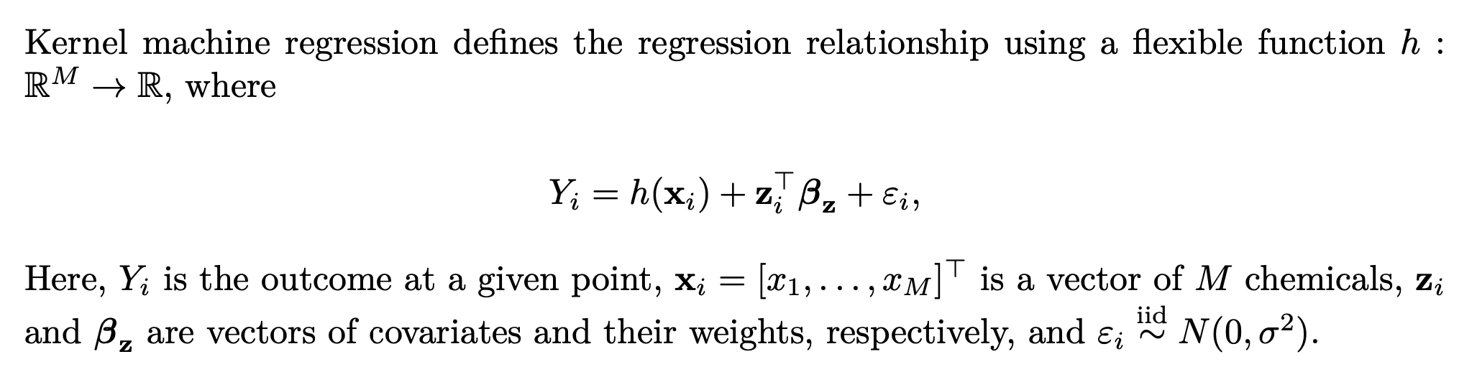
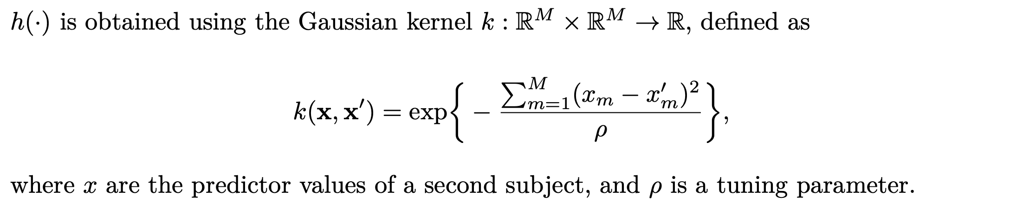
Kernel machine regression
Notes:
6:45
X and x prime

Slide 12
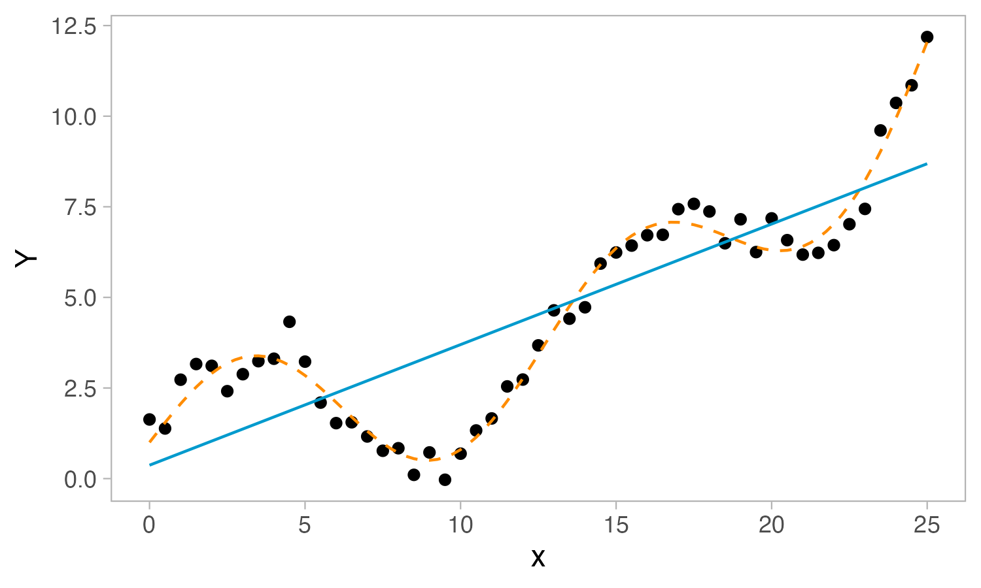
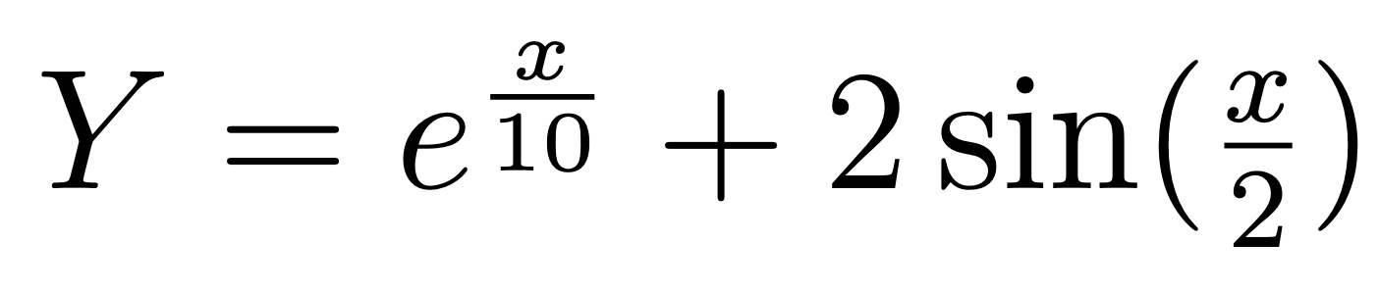
Toy example
Notes:
Plus error

Slide 13
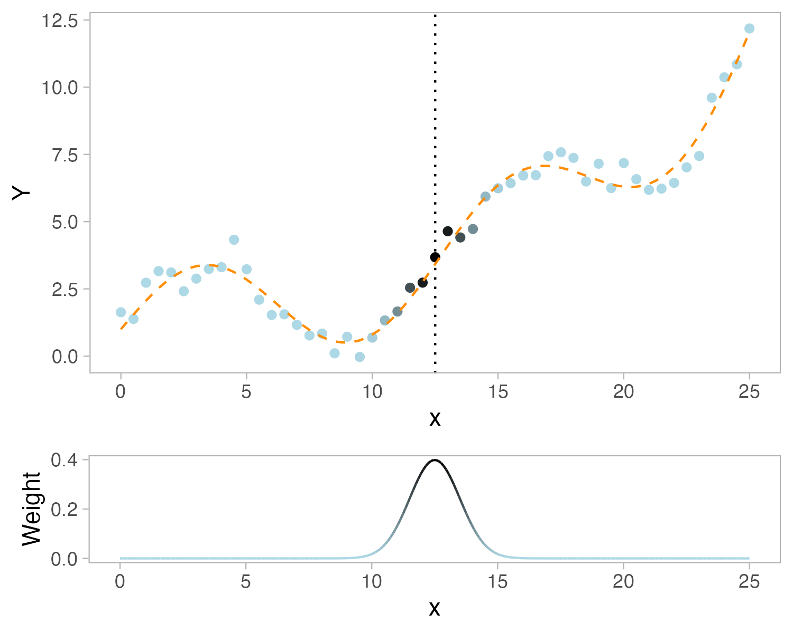
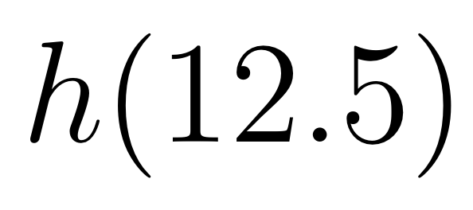
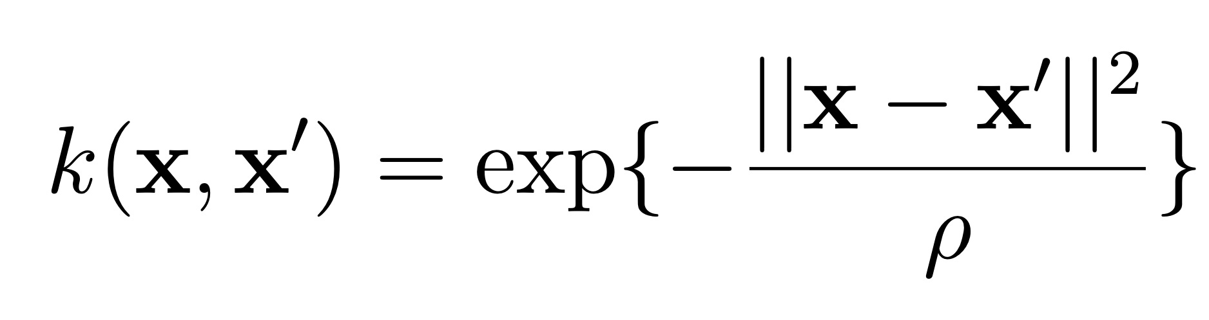
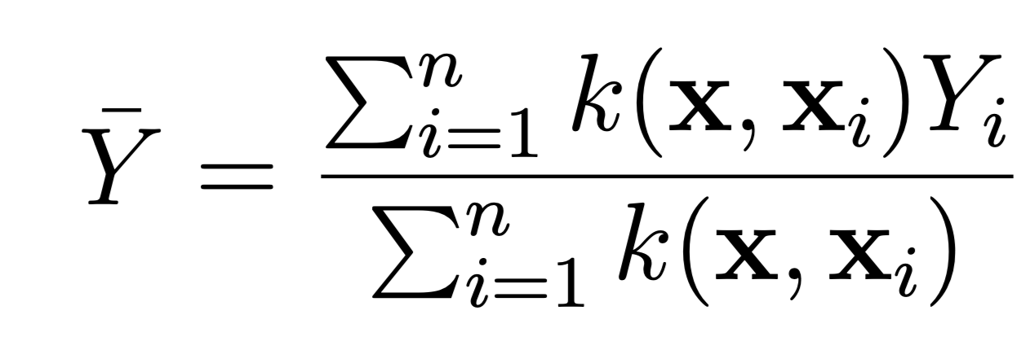
Toy example
Define a query point
Use the kernel to assign weights to neighboring points
Obtain estimate using a weighted average

Slide 14
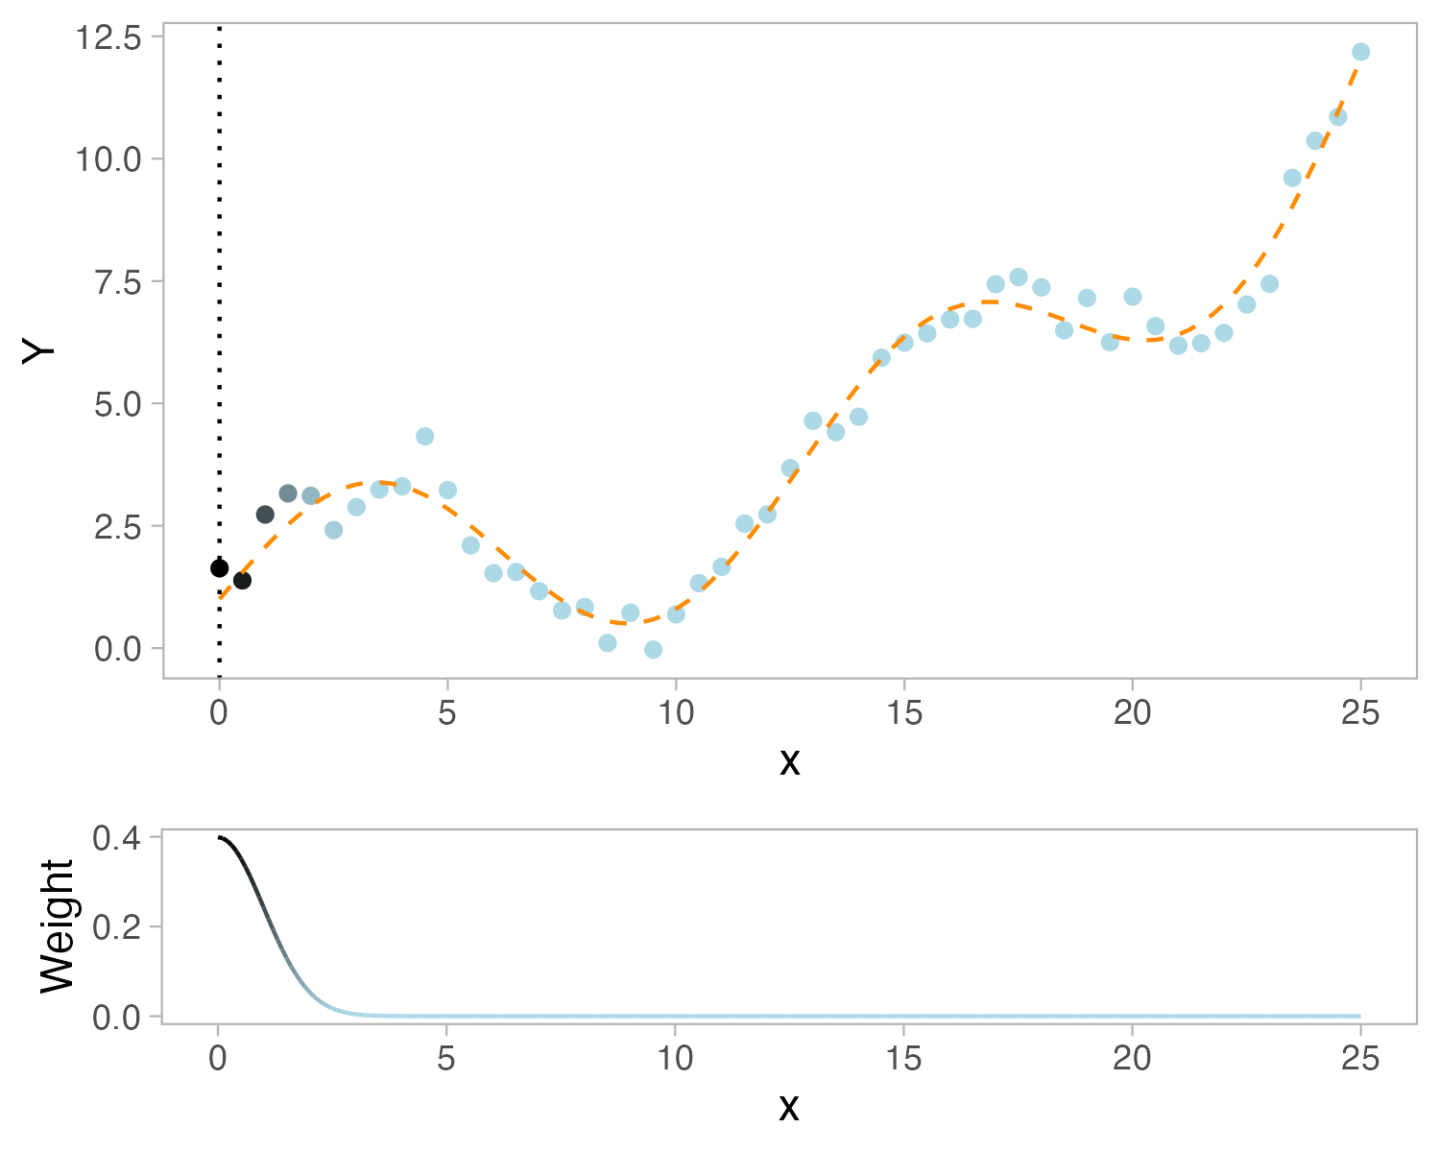
Toy example

Slide 15
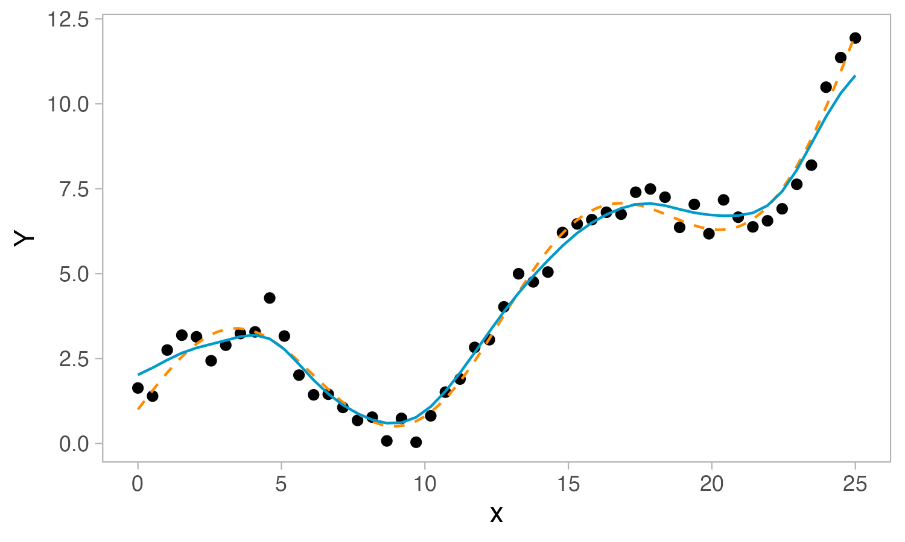
Toy example

Slide 16
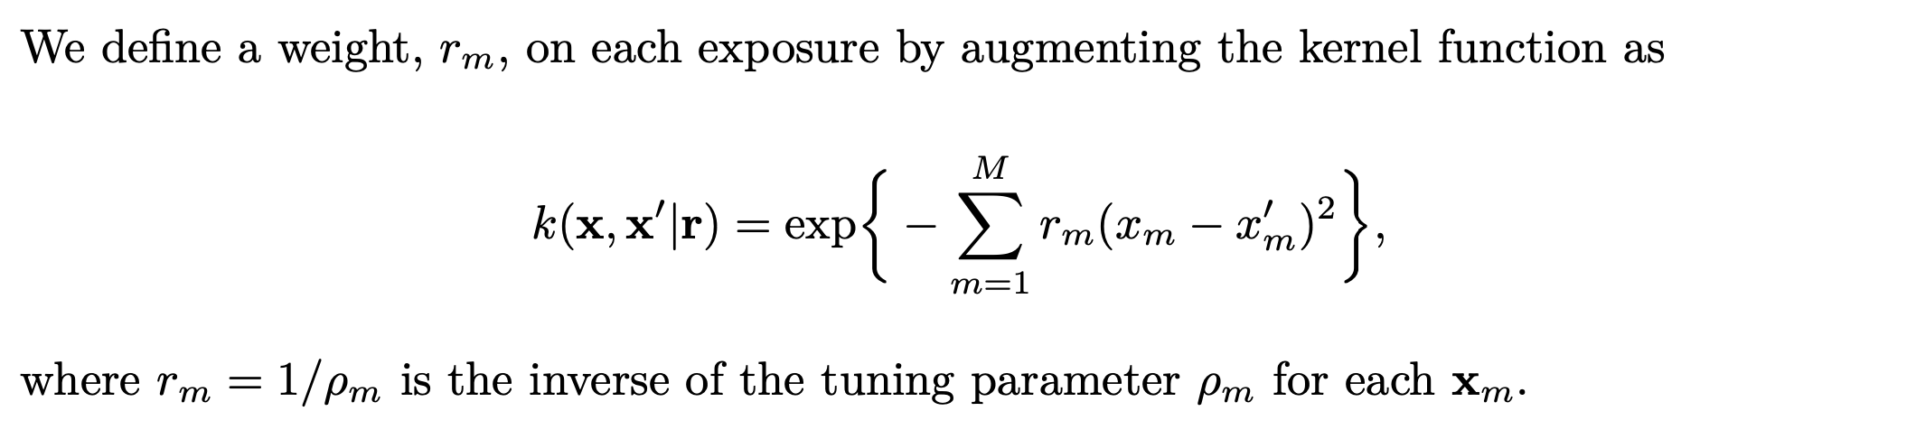
BKMR: model formulation
Extend to the Bayesian paradigm
Treat parameters as random variables, add priors
Incorporate variable selection
Notes:
Converting to a Bayesian paradigm — figure out the wording
Parameters vs. weights (adding things into the model that are going to priors)

Slide 17
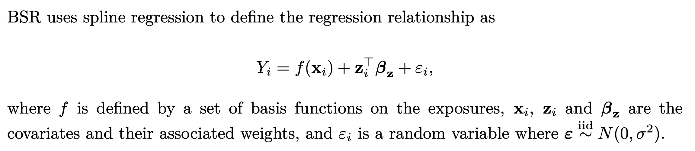
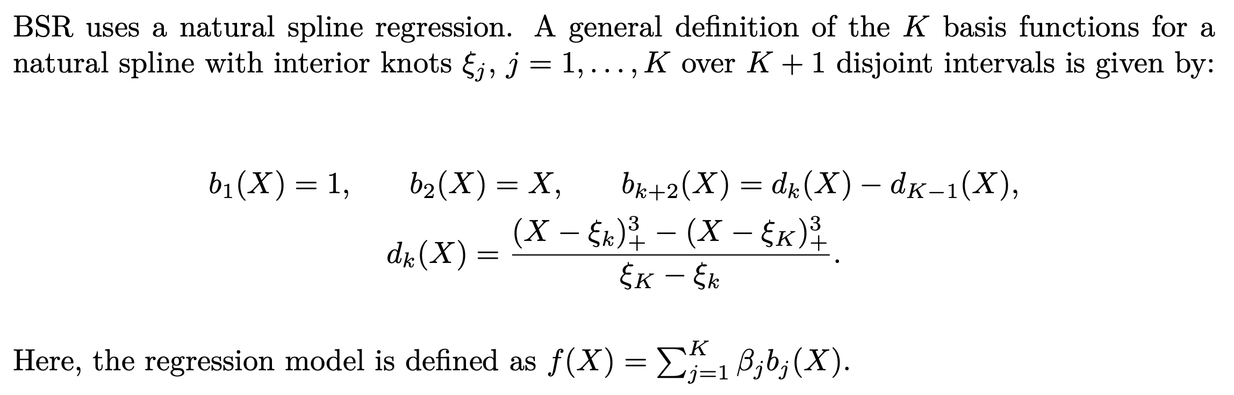
Spline regression

Slide 18
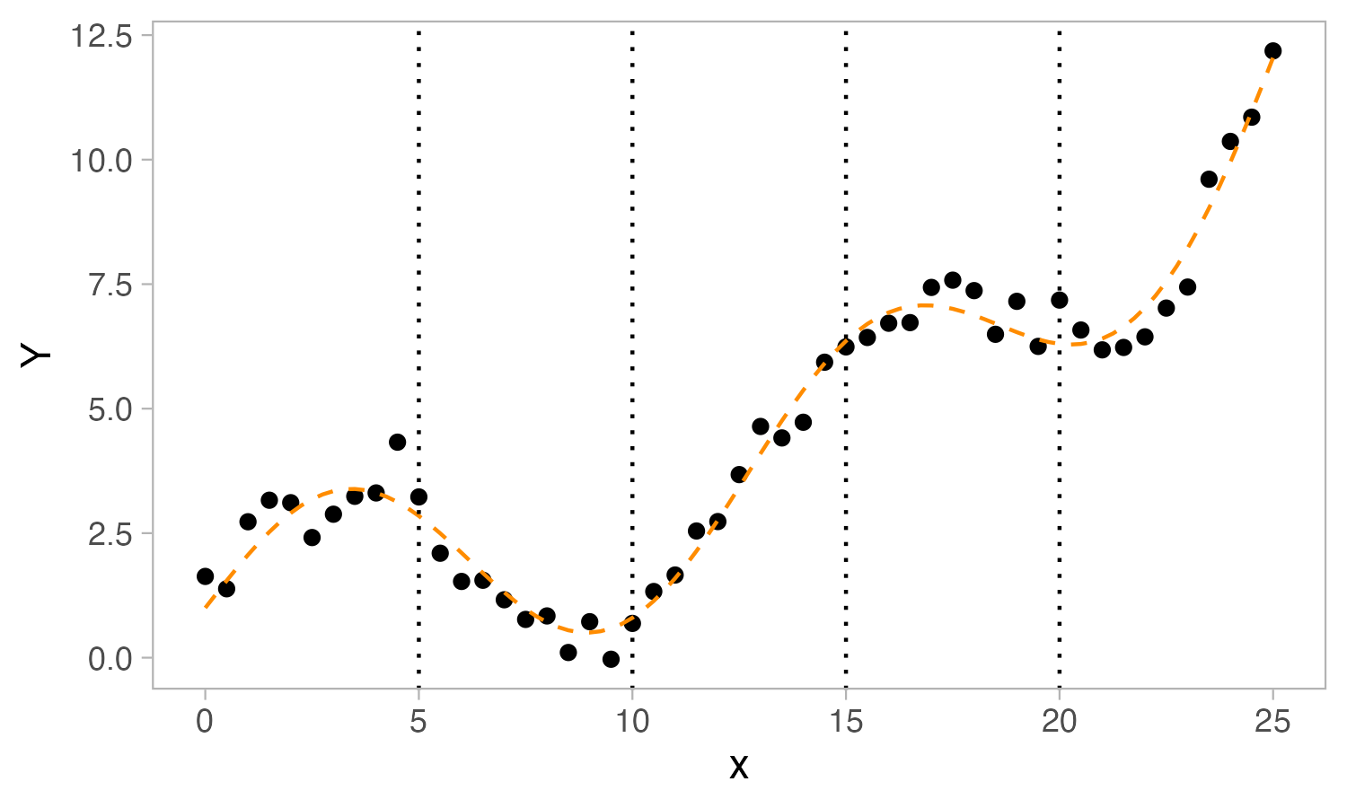
Toy example
Define 4 equally spaced knots

Slide 19
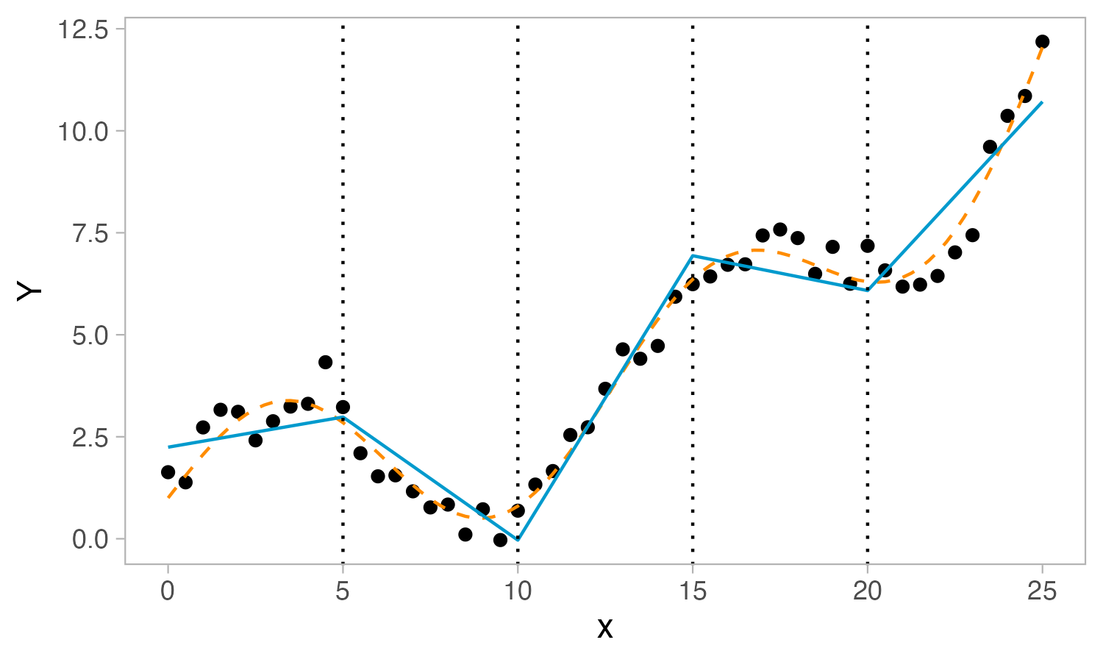
Toy example
Define 4 equally spaced knots
Fit a linear regression between each knot, imposing continuity restrictions

Slide 20
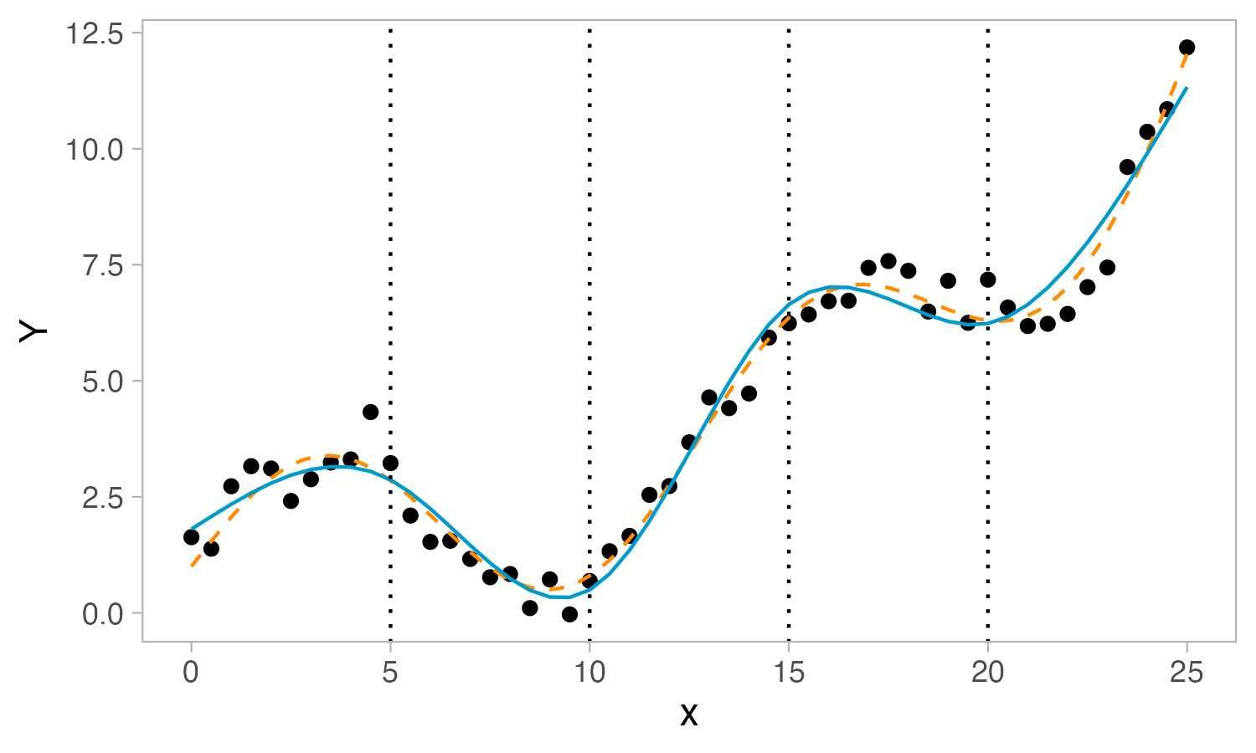
Toy example
Define 4 equally spaced knots
Fit a cubic regression between each knot, imposing continuity restrictions
→ Natural spline regression!

Slide 21
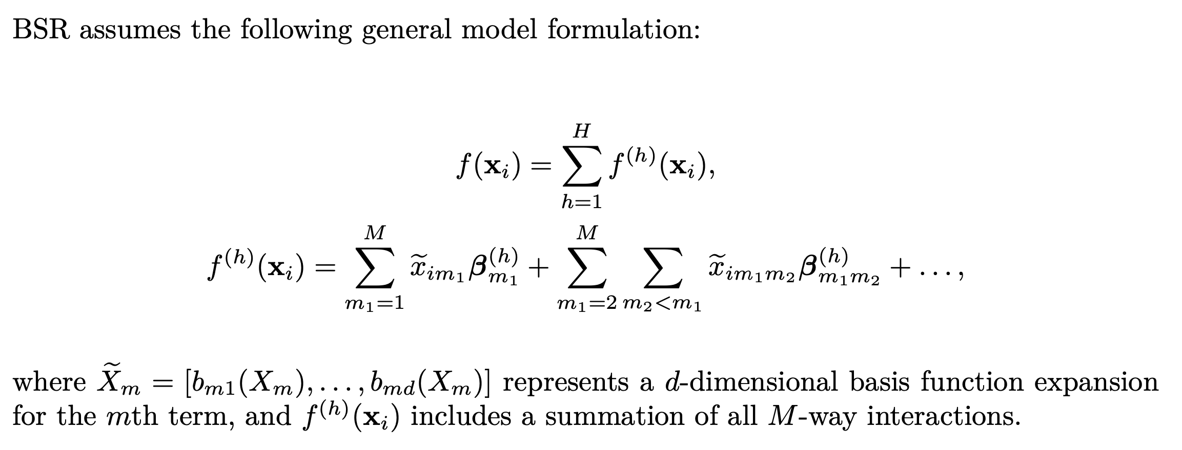
BSR: model formulation

Slide 22
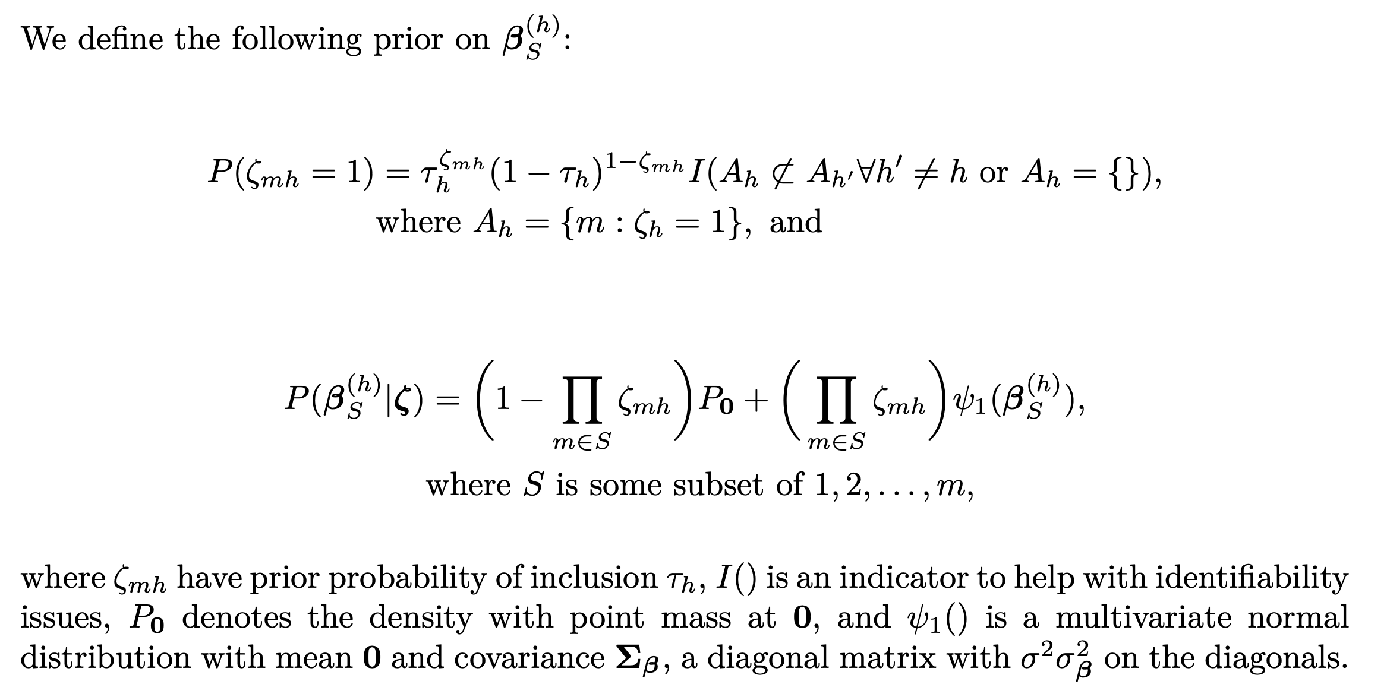
BSR: Posterior inclusion probabilities (PIPs)
Notes:
PIP — define these more!!!

Slide 23
To summarize…
BKMR is a nonparametric modeling technique
Flexibility of formulation allows for interactions to be captured
We can only get variable importance for univariate terms/chemicals
BSR is a semiparametric modeling technique
Includes interaction terms explicitly in model formulation
We can get variable importance (i.e., PIPs) for interaction terms
Notes:
15 minutes

Slide 24
Conduct a simulation study
Benchmark BKMR and BSR: what are the current capabilities of modern methods for detecting interactions?
Compare BKMR and BSR: which one should researchers pick?
Consider a wide range of interactions, and consider interactions between chemicals and covariates

Slide 25
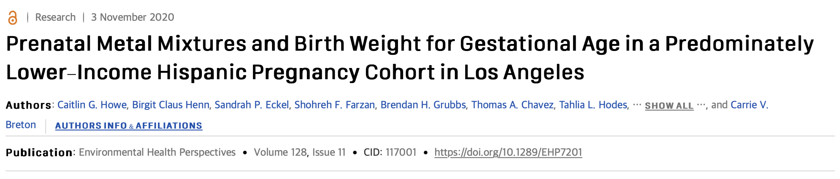
Simulating predictor data
MADRES dataset:
10 chemical exposures, 4 covariates (including race)
Use Gaussian copulas to preserve marginal distributions and correlation structure
Two sample sizes: n=252, n=1000

Slide 26
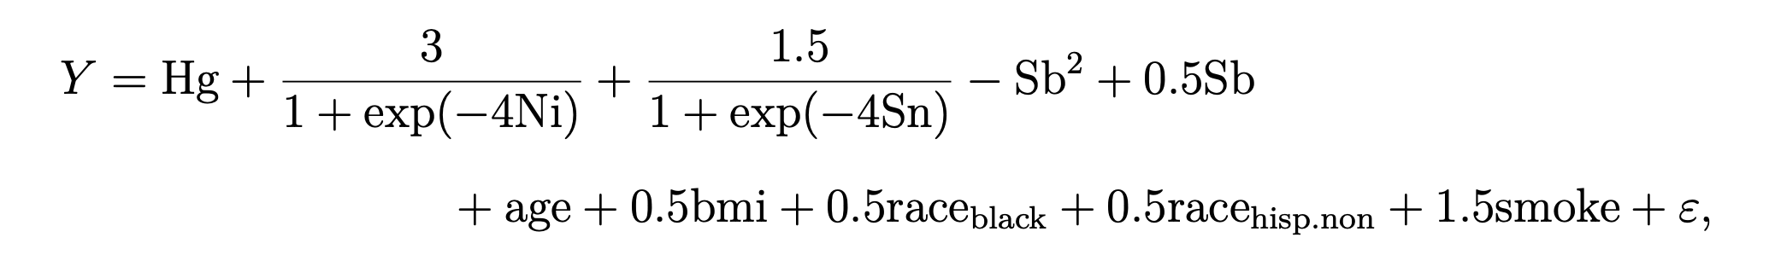
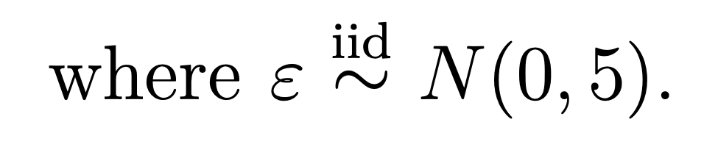
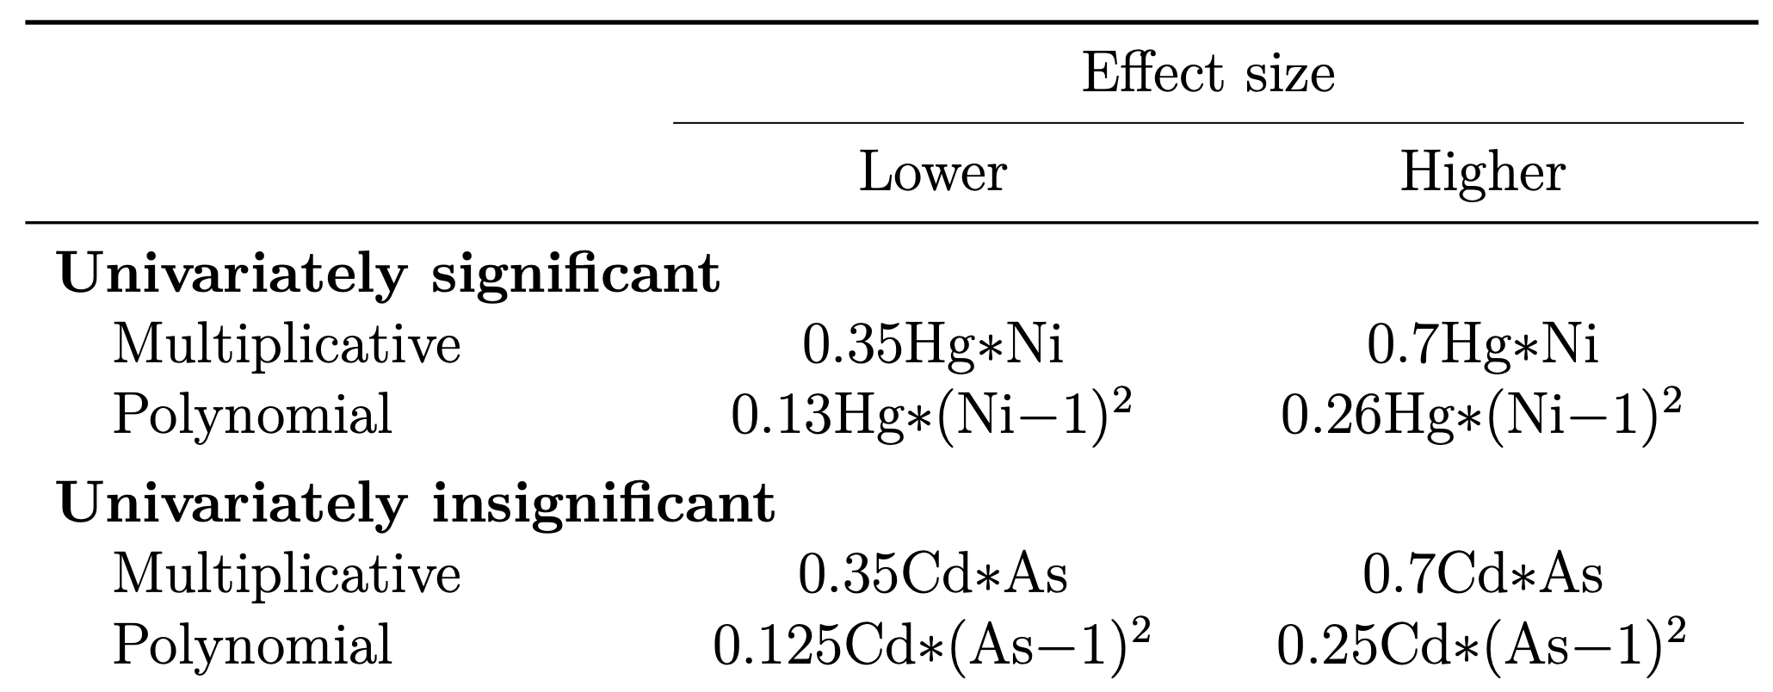
Simulating the outcome

Slide 27
Models
Multiple linear regression with the true form of interactions specified
“Oracle MLR”
BKMR
BSR

Slide 28
Model assessment
Sensitivity: the proportion of times a significant interaction is successfully detected by the model
p-values for oracle MLR
Confidence interval approach for BKMR
(less formal)
PIPs for BSR
(more formal)
Notes:
18.5 minutes

Slide 29
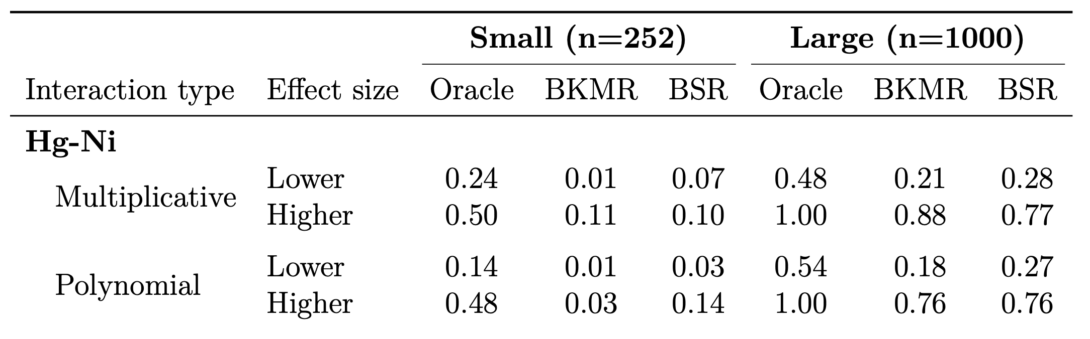
Sensitivity to Hg-Ni (univariately significant)

Slide 30
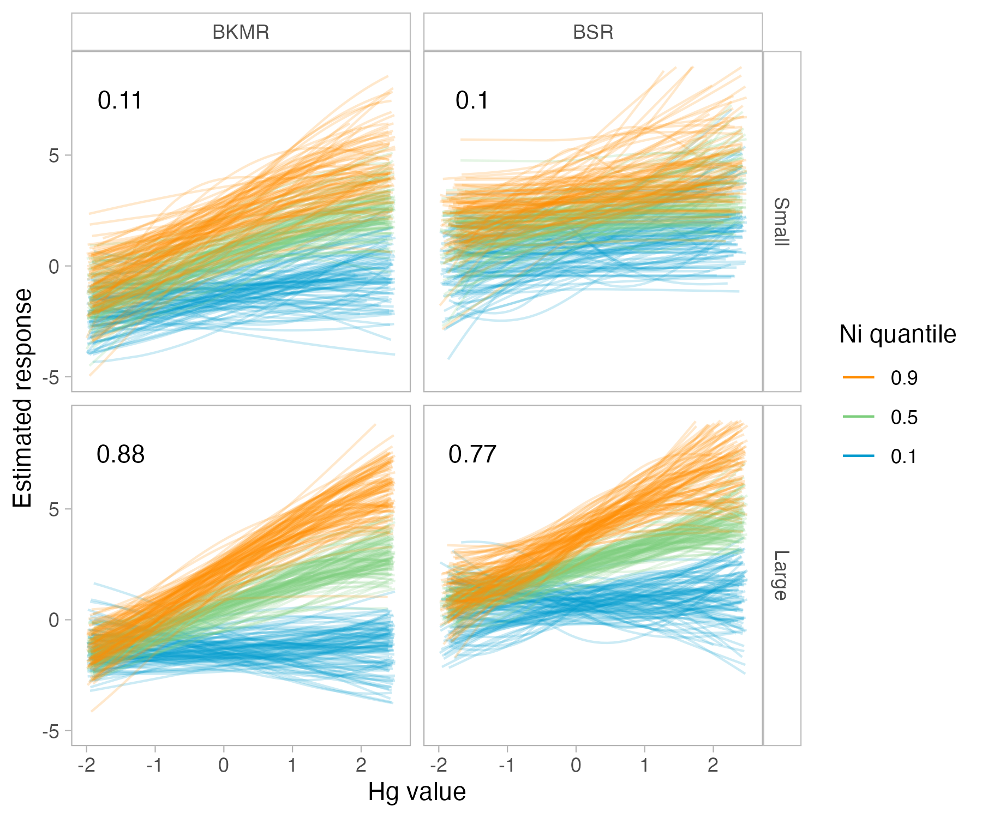
Visual assessment
(nickel)
(mercury)
(mercury)

Slide 31
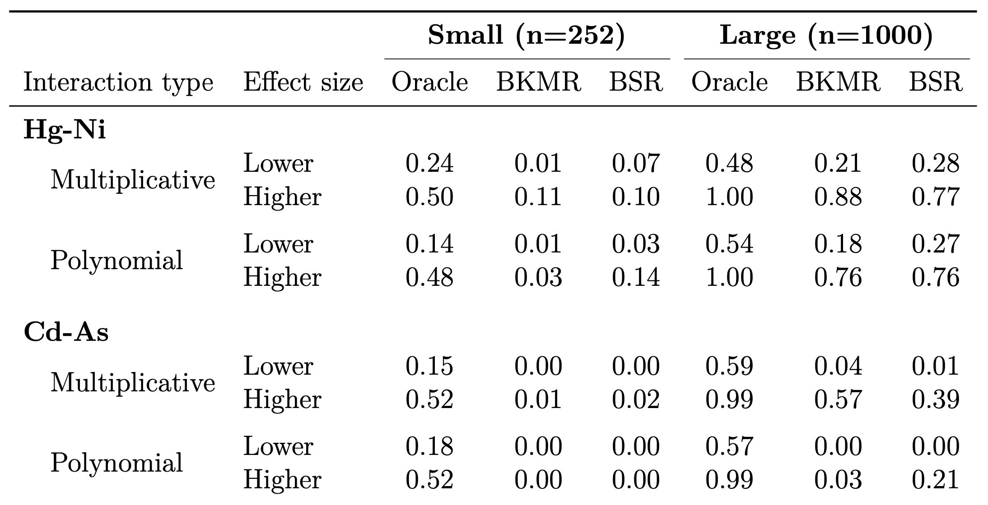
Sensitivity to Cd-As (univariately insignificant)
Notes:
22 minutes

Slide 32
Conclusions
Use BKMR first to characterize the overall exposure mixture
Use BSR to verify interactions with formal PIPs
Interactions are challenging to detect
Especially in smaller sample sizes, or between univariately insignificant chemicals
⟶ More methodological research in this area can considerably improve accuracy of risk assessments
Notes:
24 minutes

Slide 33
Acknowledgements
Thank you so much to the following people for their support: Amy Wagaman, Alex Keil, Shu-Min Liao, Victoria Nguyen, Doug Hall, the faculty, staff, and my peers in the Department of Mathematics and Statistics, and my friends and family.
This work was performed in part using high-performance computing equipment at Amherst College obtained under National Science Foundation Grant Number 2117377. The data used for simulations in this thesis was supported by the National Institute of Environmental Health Sciences of the National Institutes of Health under Award Numbers U2CES026555 and U2CES026553. The content is solely the responsibility of the author and does not necessarily represent the official views of the National Science Foundation or the National Institutes of Health.

Slide 34
References
Antonelli, J., Mazumdar, M., Bellinger, D., Christiani, D., Wright, R., & Coull, B. (2020). Estimating the health effects of environmental mixtures using Bayesian semiparametric regression and sparsity inducing priors. The Annals of Applied Statistics, 14(1), 257–275. https://doi.org/10.1214/19-AOAS1307
Bobb, J. F., Valeri, L., Claus Henn, B., Christiani, D. C., Wright, R. O., Mazumdar, M., Godleski, J. J., & Coull, B. A. (2015). Bayesian kernel machine regression for estimating the health effects of multi-pollutant mixtures. Biostatistics, 16(3), 493–508. https://doi.org/10.1093/biostatistics/kxu058
Environmental Protection Agency. (1998). 1.4 Natural Gas Combustion. In AP-42, Compilation of Air Pollutant Emissions Factors from Stationary Sources (5th ed., Vol. 1). Environmental Protection Agency. https://www.epa.gov/air-emissions-factors-and-quantification/ap-42-fifth-edition-volume-i-chapter-1-external-0
Hastie, T., Tibshirani, R., & Friedman, J. (2009). The Elements of Statistical Learning. Springer New York. https://doi.org/10.1007/978-0-387-84858-7
Howe, C. G., Claus, H. B., Eckel, S. P., Farzan, S. F., Grubbs, B. H., Chavez, T. A., Hodes, T. L., Faham, D., Al, -Marayati Laila, Lerner, D., Quimby, A., Twogood, S., Richards, M. J., Meeker, J. D., Bastain, T. M., & Breton, C. V. (2020). Prenatal Metal Mixtures and Birth Weight for Gestational Age in a Predominately Lower-Income Hispanic Pregnancy Cohort in Los Angeles. Environmental Health Perspectives, 128(11), 117001. https://doi.org/10.1289/EHP7201
Thangavel, P., Park, D., & Lee, Y.-C. (2022). Recent Insights into Particulate Matter (PM2.5)-Mediated Toxicity in Humans: An Overview. International Journal of Environmental Research and Public Health, 19(12), Article 12. https://doi.org/10.3390/ijerph19127511
Vermeulen, R., Schymanski, E. L., Barabási, A.-L., & Miller, G. W. (2020). The exposome and health: Where chemistry meets biology. Science, 367(6476), 392–396. https://doi.org/10.1126/science.aay3164
Ward, J. B., Gartner, D. R., Keyes, K. M., Fliss, M. D., McClure, E. S., & Robinson, W. R. (2019). How do we assess a racial disparity in health? Distribution, interaction, and interpretation in epidemiological studies. Annals of Epidemiology, 29, 1–7. https://doi.org/10.1016/j.annepidem.2018.09.007
Yu, L., Liu, W., Wang, X., Ye, Z., Tan, Q., Qiu, W., Nie, X., Li, M., Wang, B., & Chen, W. (2022). A review of practical statistical methods used in epidemiological studies to estimate the health effects of multi-pollutant mixture. Environmental Pollution, 306, 119356. https://doi.org/10.1016/j.envpol.2022.119356

Slide 35
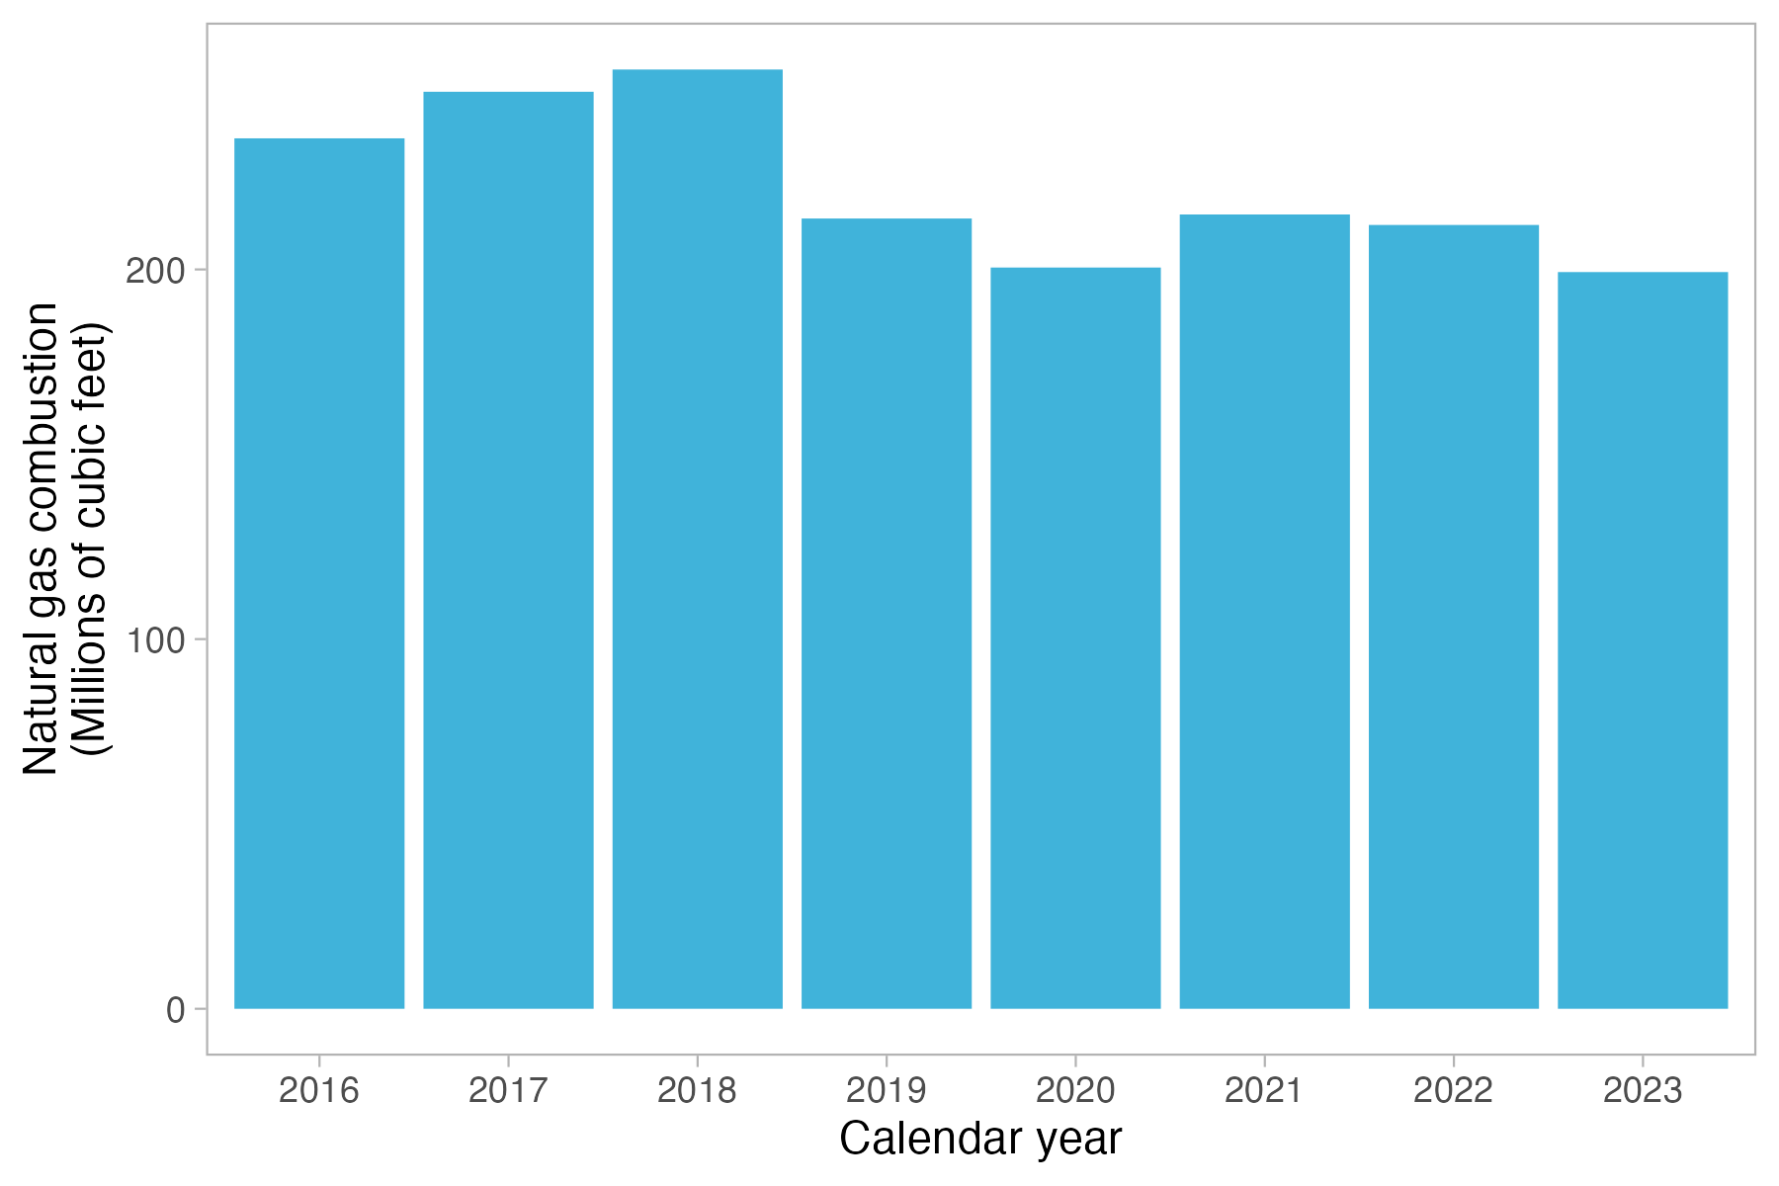
Natural gas from the cogen plant

Slide 36
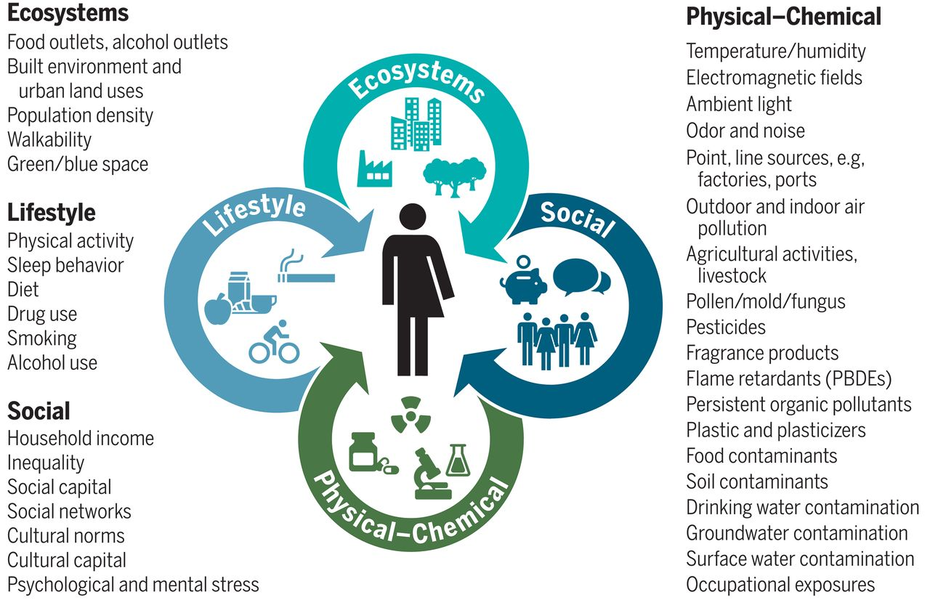
A mixtures approach

Slide 37
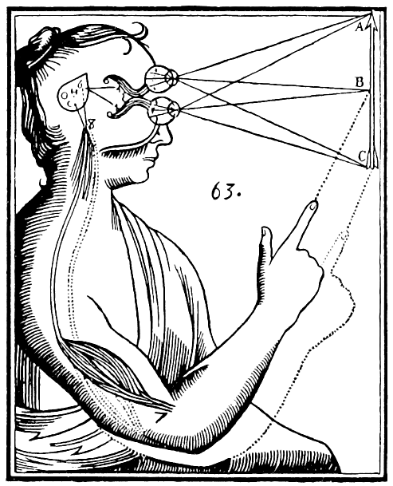

Moving past the idea of boundedness

Slide 38
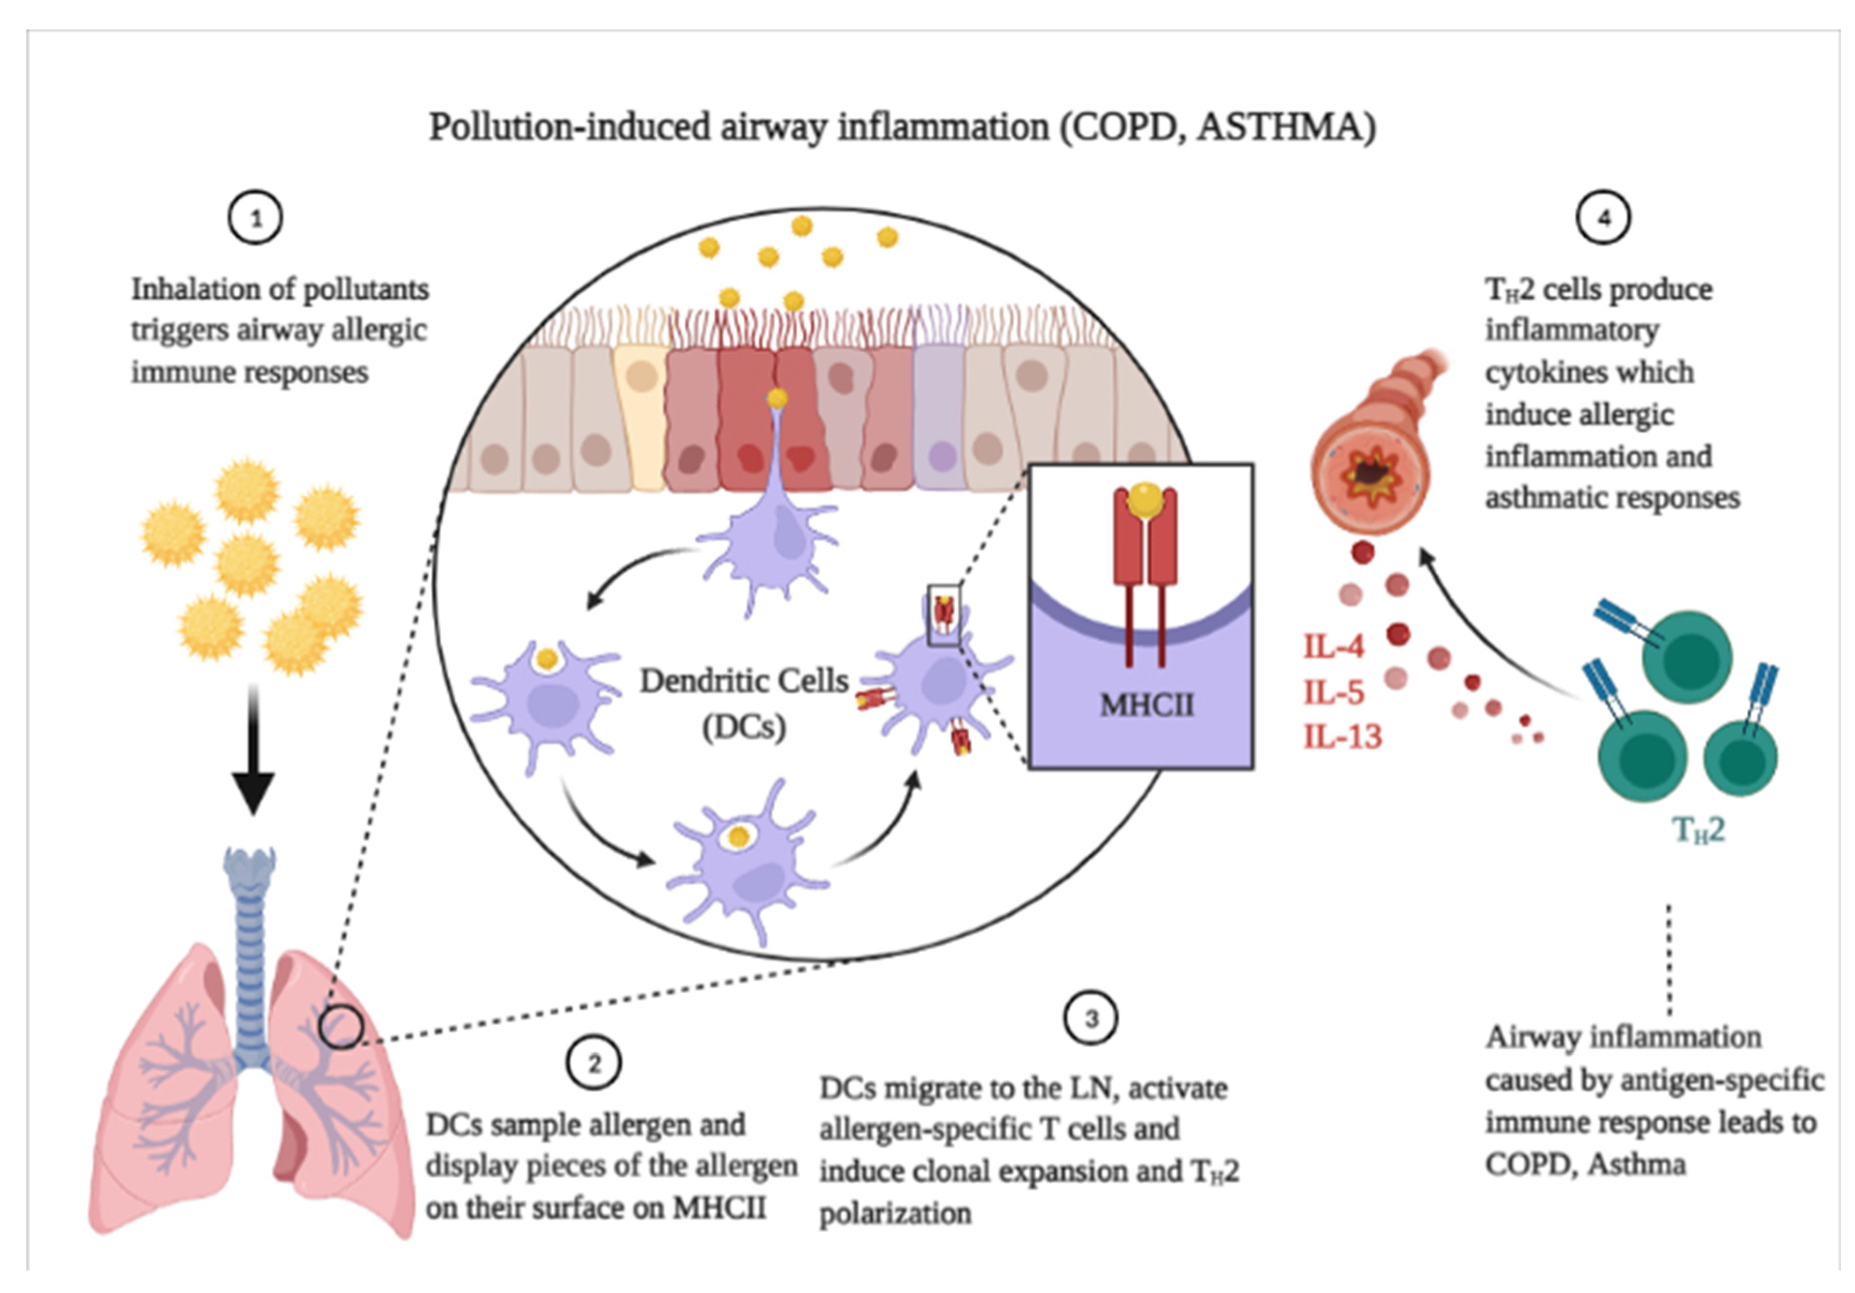
Interactions can exist between chemicals

Slide 39
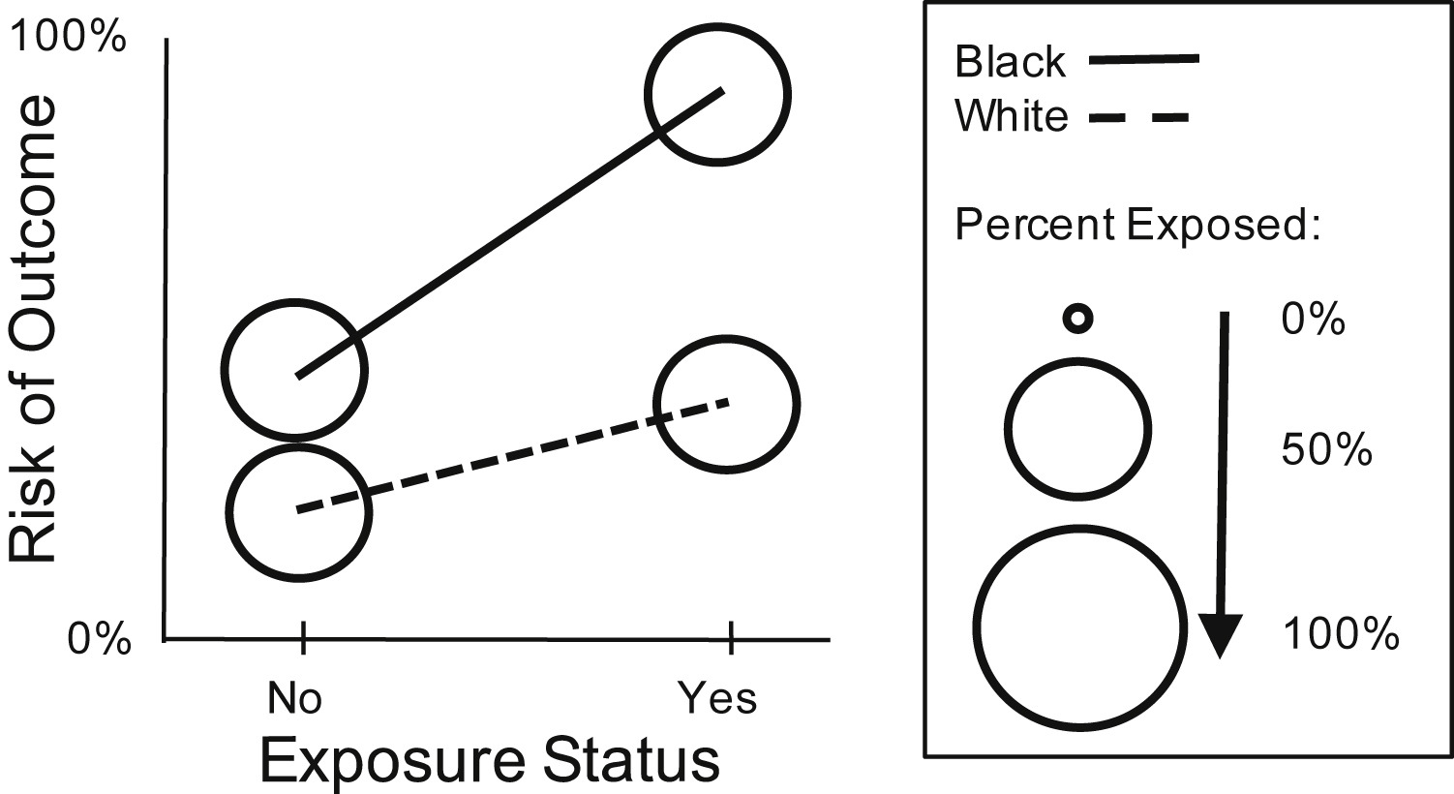
Interactions can exist between chemicals and a sociodemographic covariate

Slide 40
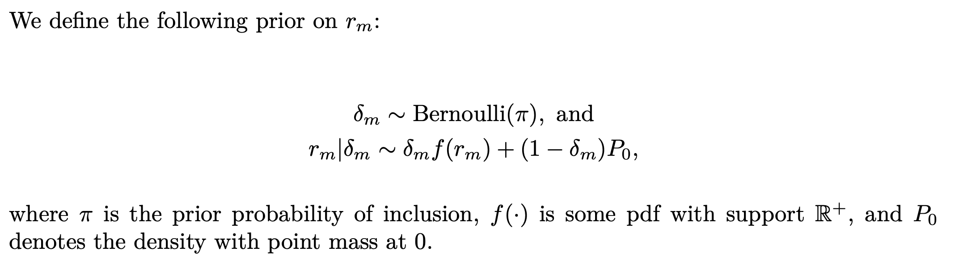
BKMR: Posterior inclusion probabilities (PIPs)

Slide 41
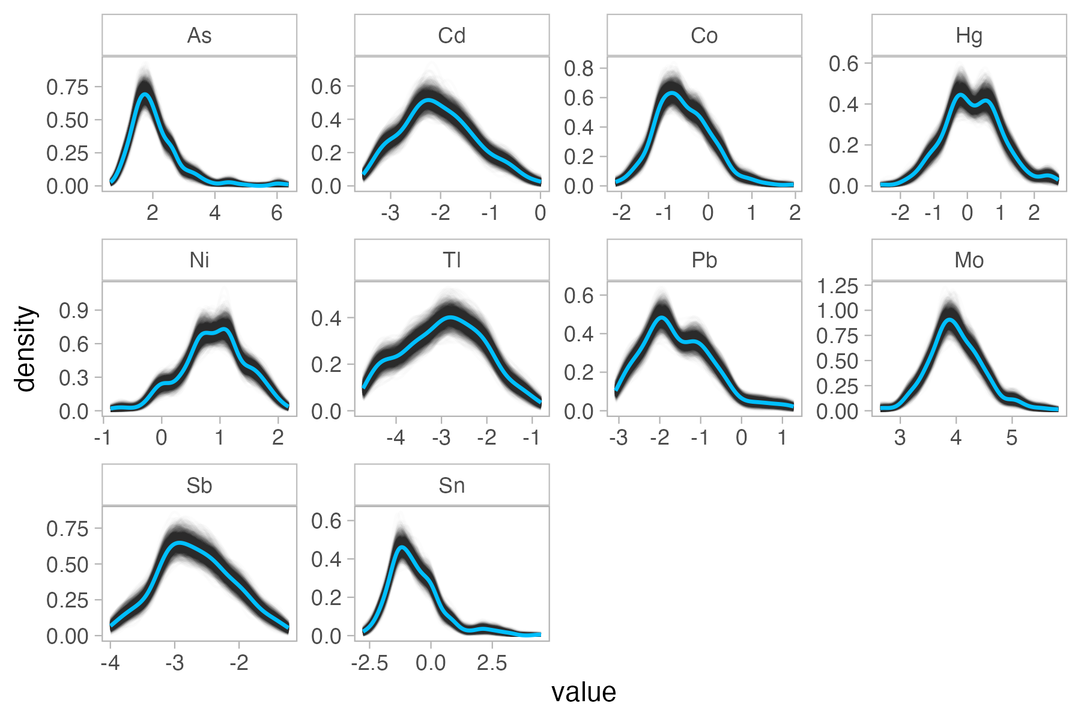
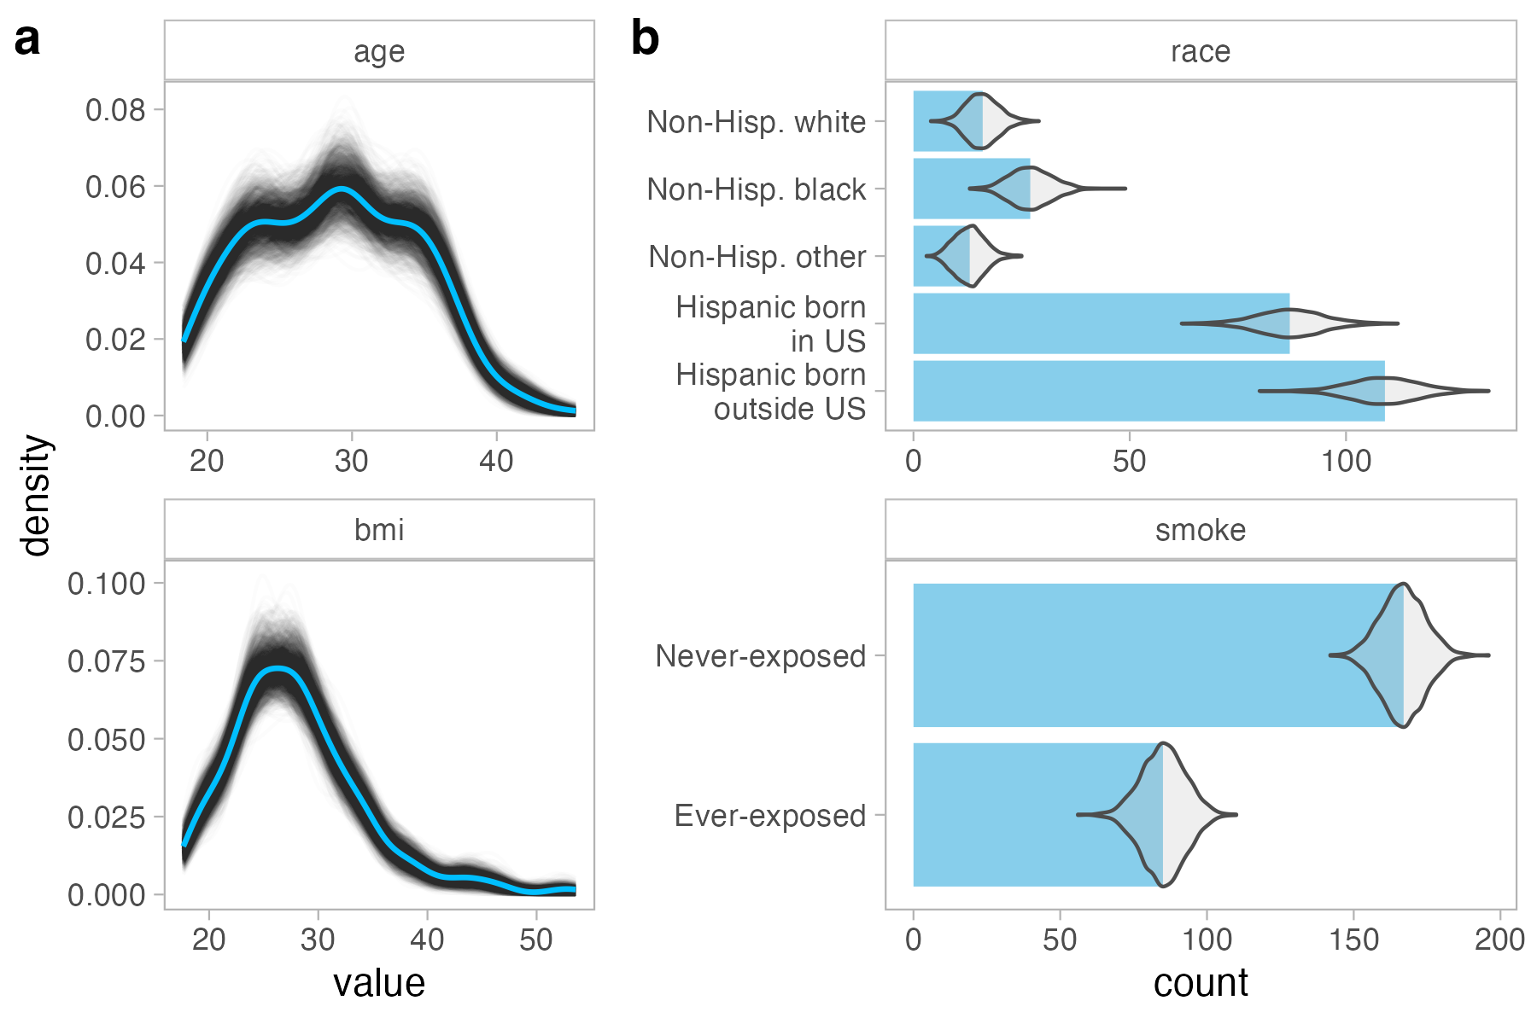
Simulated predictor data: marginals

Slide 42
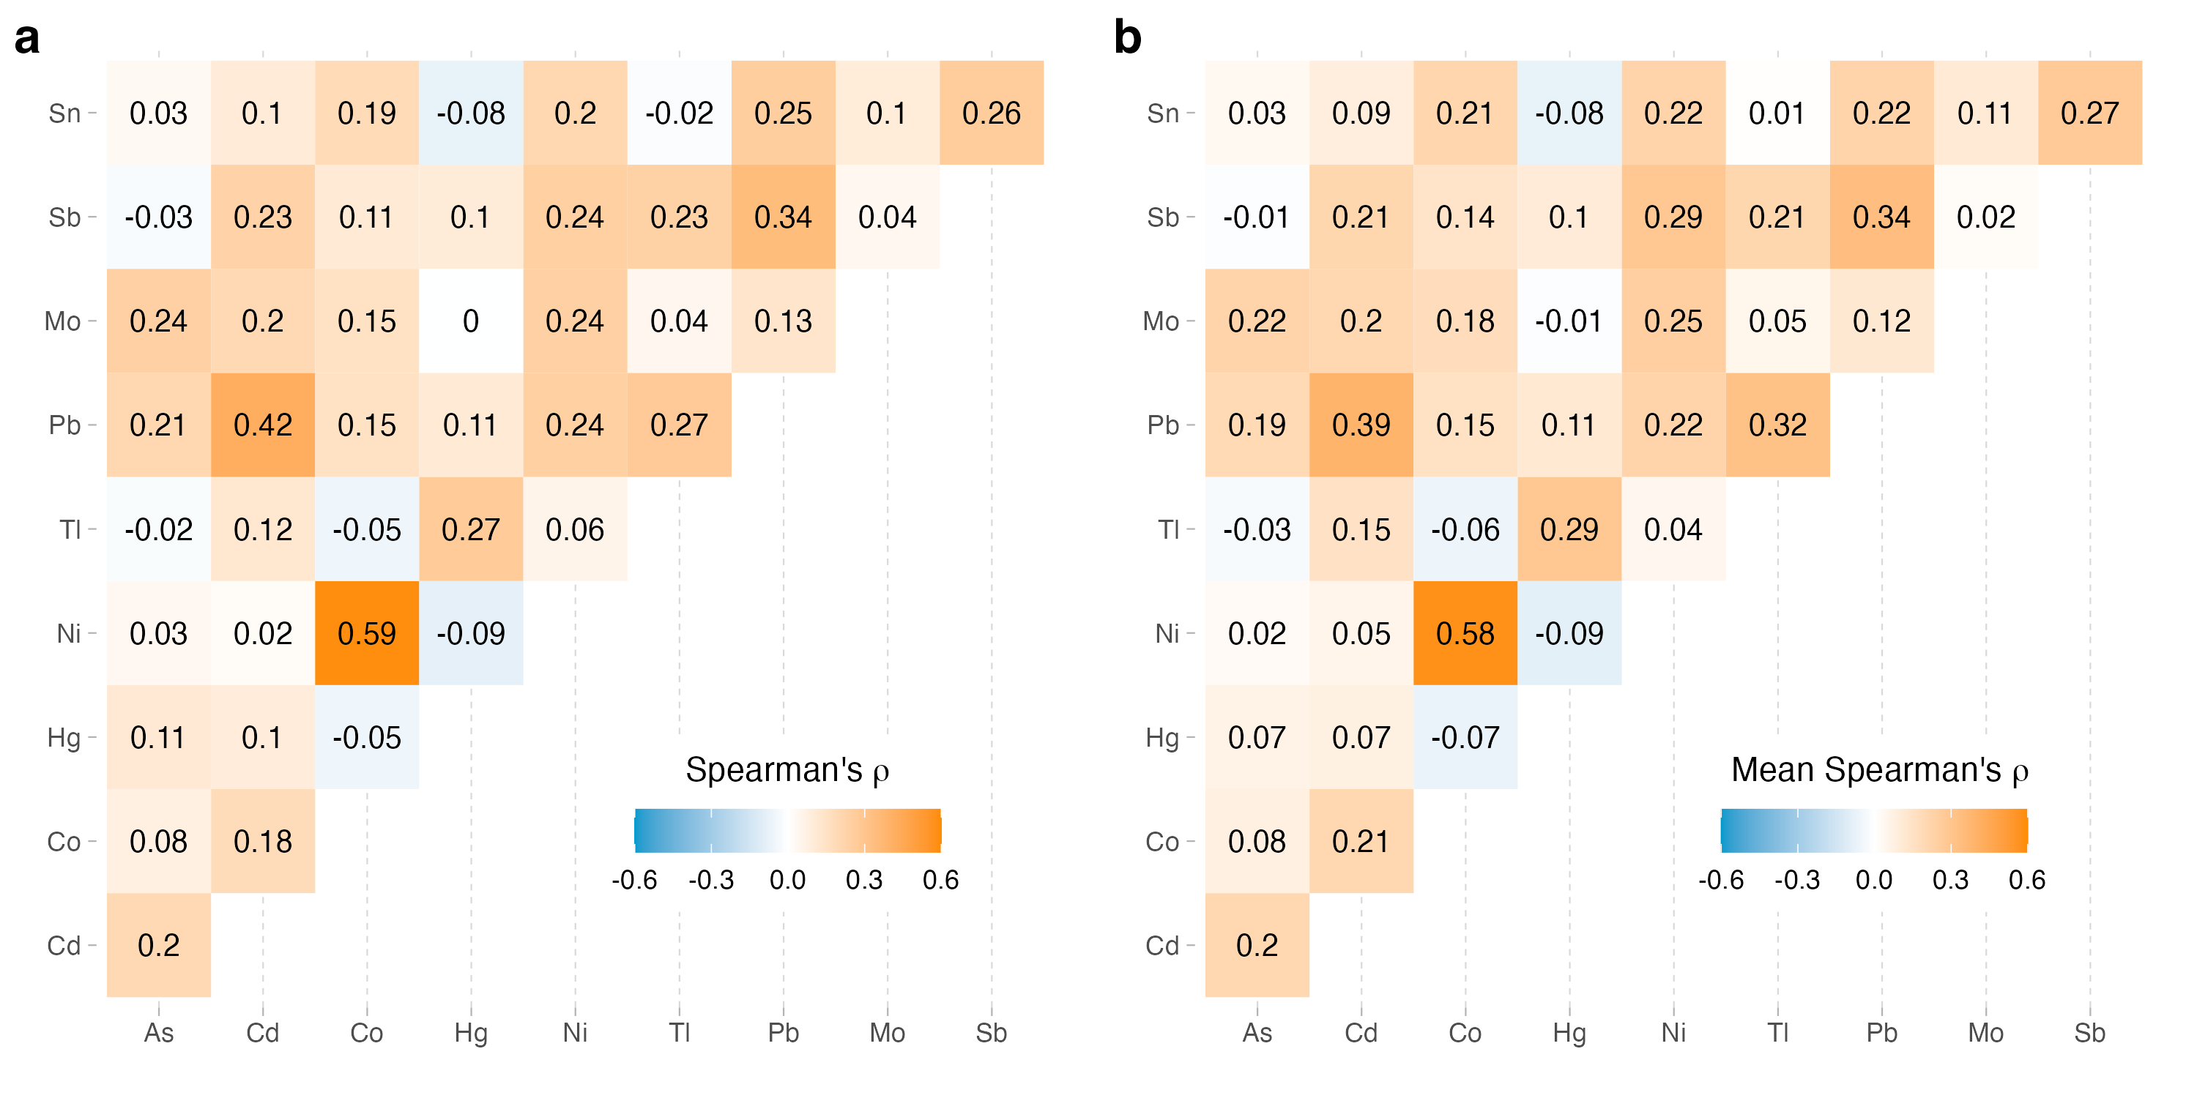
Simulated predictor data: correlation

Slide 43
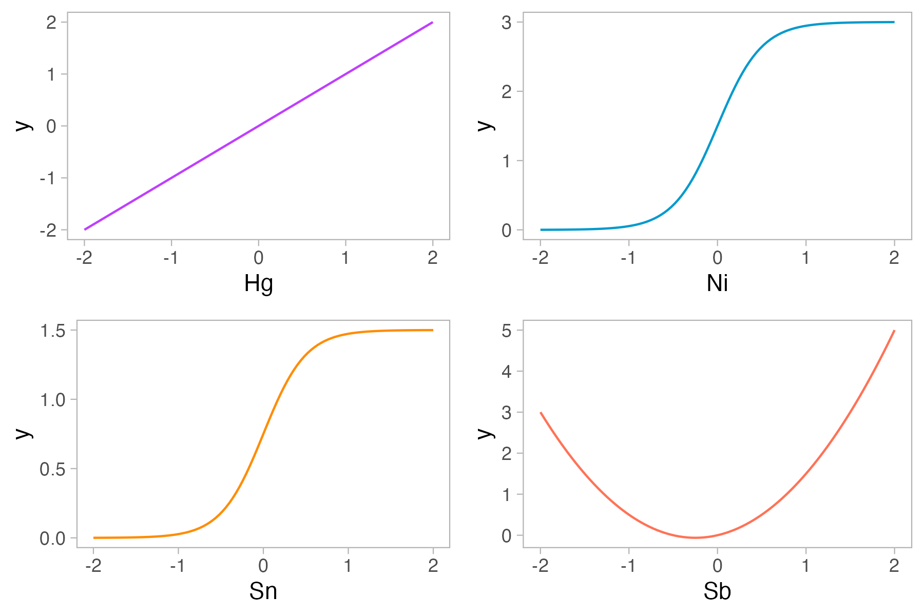
Univariate exposure-response relationships

Slide 44
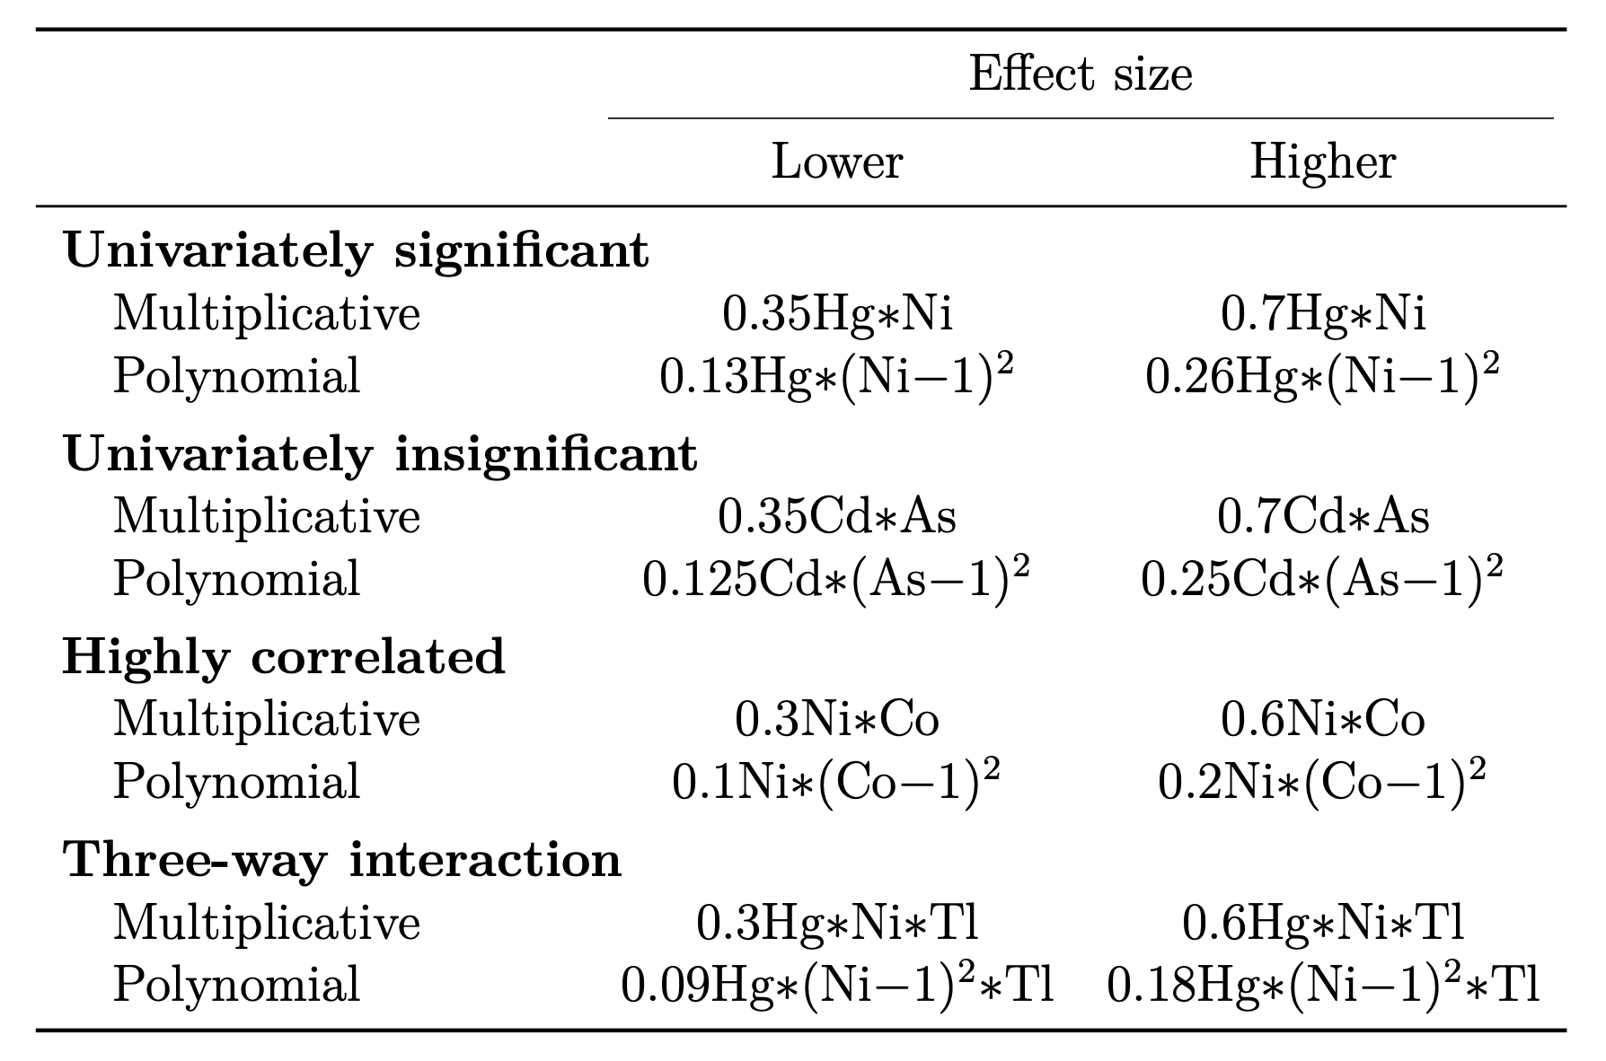
All scenarios with interactions between chemicals

Slide 45
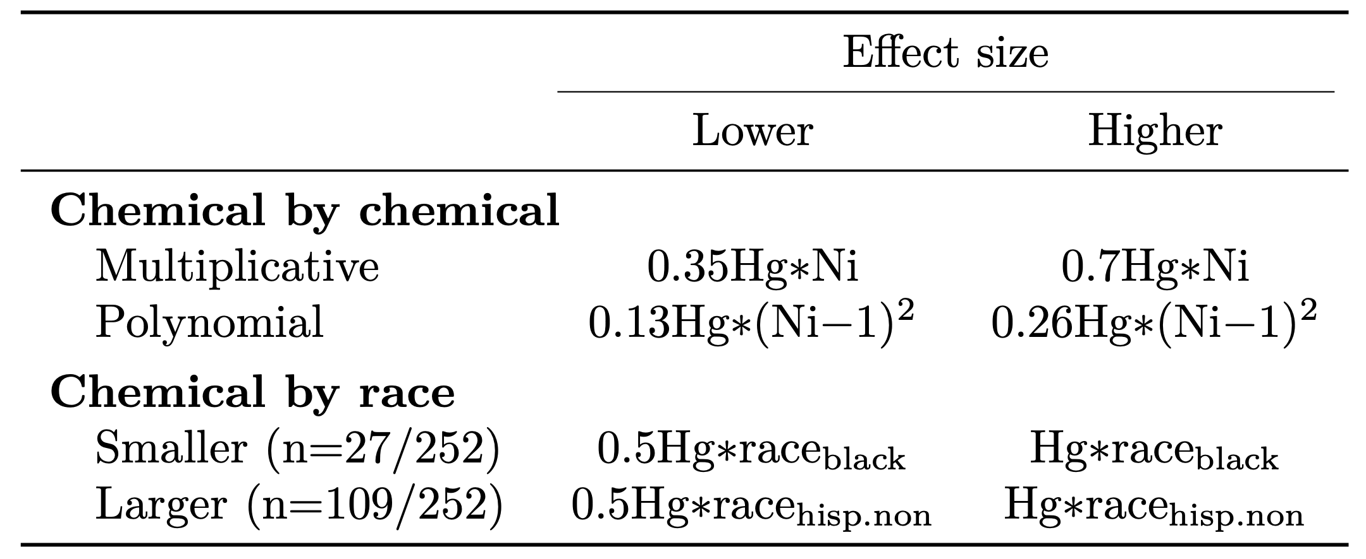
Interactions between Hg and race

Slide 46
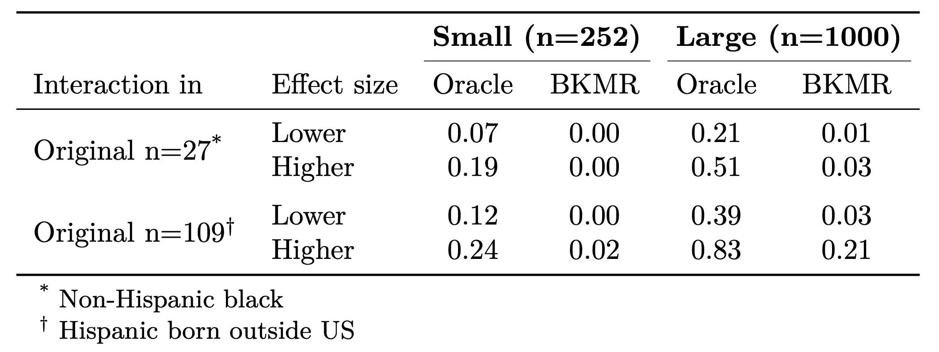
Sensitivity to chemical by race

Slide 47
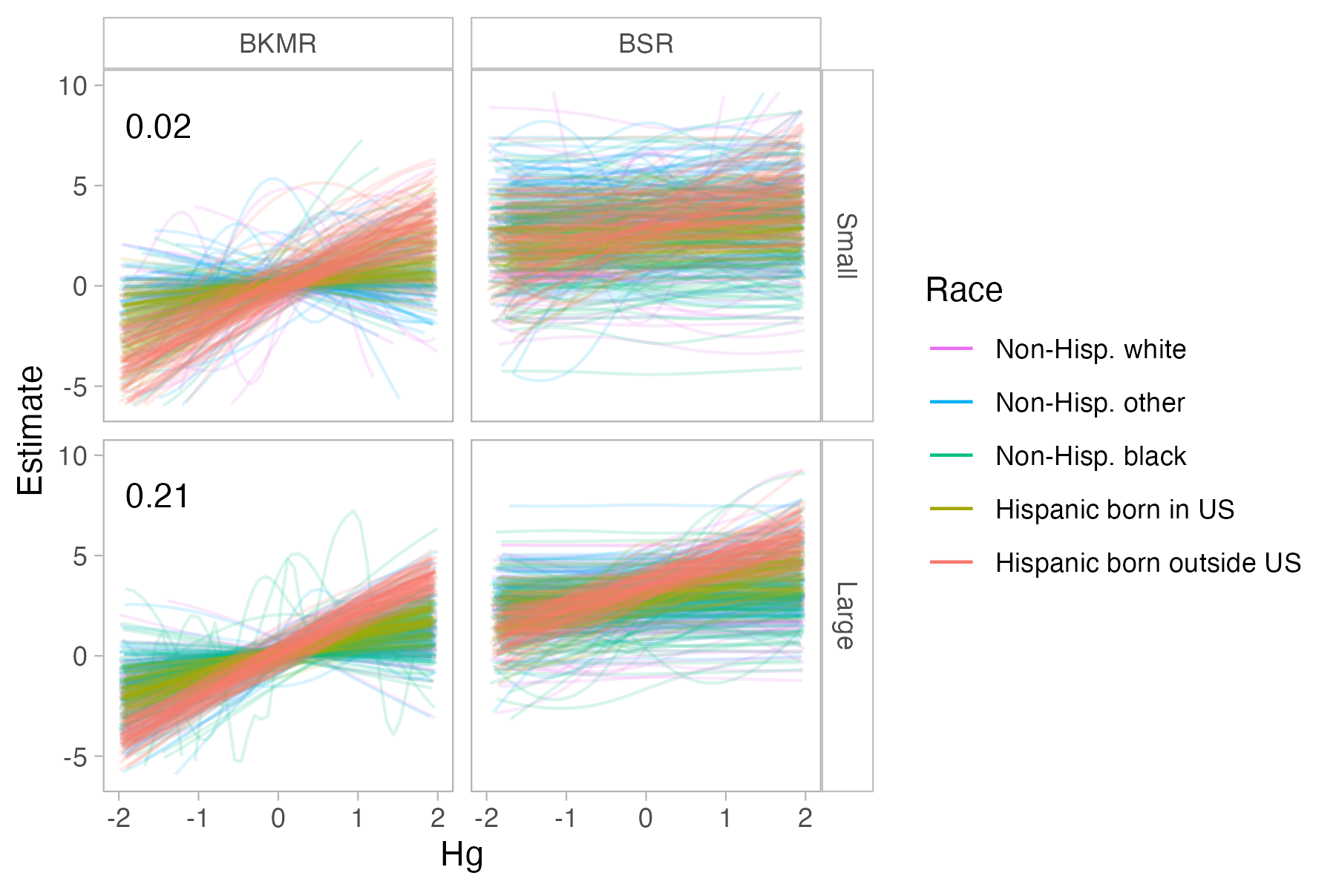
Visual assessment

Slide 48
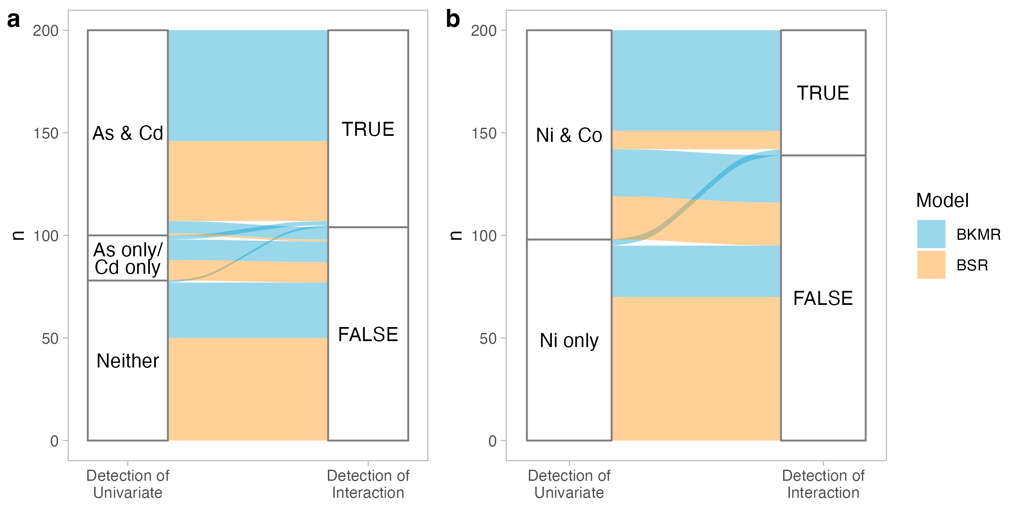
Flow chart

Slide 49



Hg-Ni surfaces
Multiplicative interaction: +0.35Hg*Ni
No interaction: Hg + 3/(1+exp(-4Ni))
Polynomial interaction: +0.13Hg*(Ni-1)²

Slide 50

Full visual assessment of Hg-Ni

Slide 51

Full visual assessment of race-Hg

Slide 52

Run-times

Slide 53

Run-times of stratified models

